Slide 1

Operating Systems
Summary

Slide 2
Content List
Introduction
OS Services
Process
Threads
CPU Scheduling
Synchronization Tools
Deadlock
Memory
Virtual Memory

Slide 3
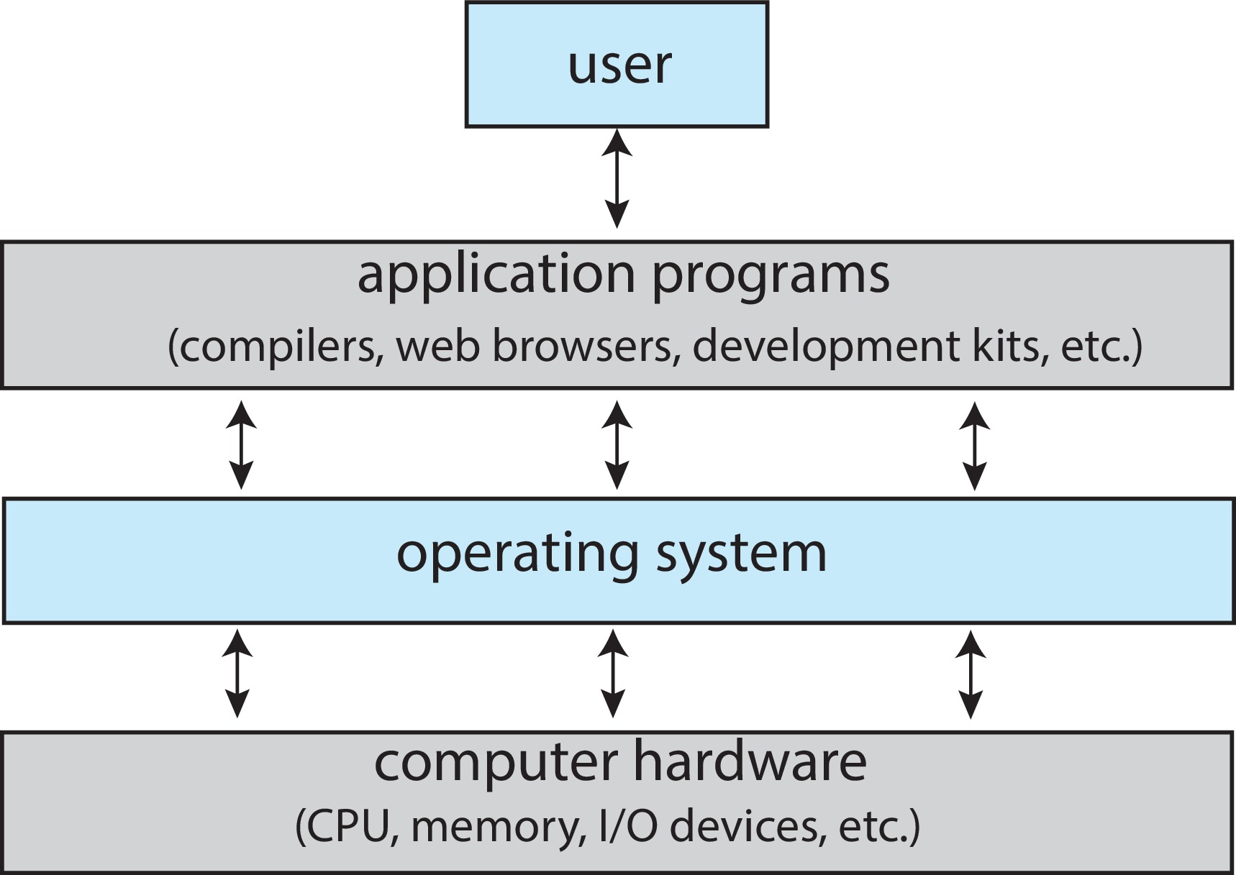
What is an Operating System?
An operating system is software that manages a computer’s hardware.
A program that acts as an intermediary between a user of a computer and the computer hardware
Operating system goals:
Execute user programs and make solving user problems easier
Make the computer system convenient to use
Use the computer hardware in an efficient manner

Slide 4
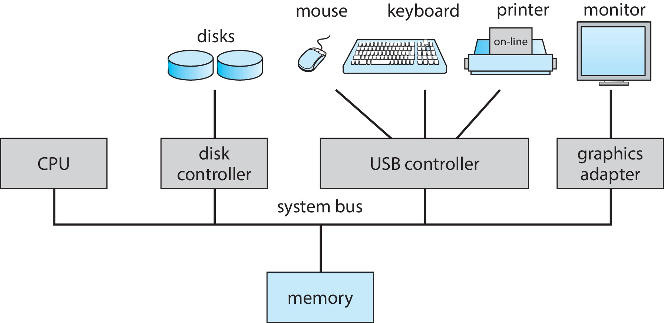
Intro. To OS
Evolution of Operating Systems:
Hardware upgrades
New types of hardware
New services
Fixes
Computer System Organization

Slide 5
Computer-System Operation
I/O devices and the CPU can execute concurrently
Each device controller oversees a particular device type
Each device controller has a local buffer
Operating systems have a device driver to manage each device controller
CPU moves data from/to main memory to/from local buffers
Device controller informs CPU that it has finished its operation by causing an interrupt

Slide 6
Interrupts
Interrupts: Mechanism by which other modules may interrupt the normal sequencing of the processor
A trap or exception is a software-generated interrupt caused either by an error or a user request
An operating system is interrupt driven
Interrupt Handling:
The operating system preserves the state of the CPU by storing the registers and the program counter
Determines which type of interrupt has occurred
Separate segments of code determine what action should be taken for each type of interrupt

Slide 7
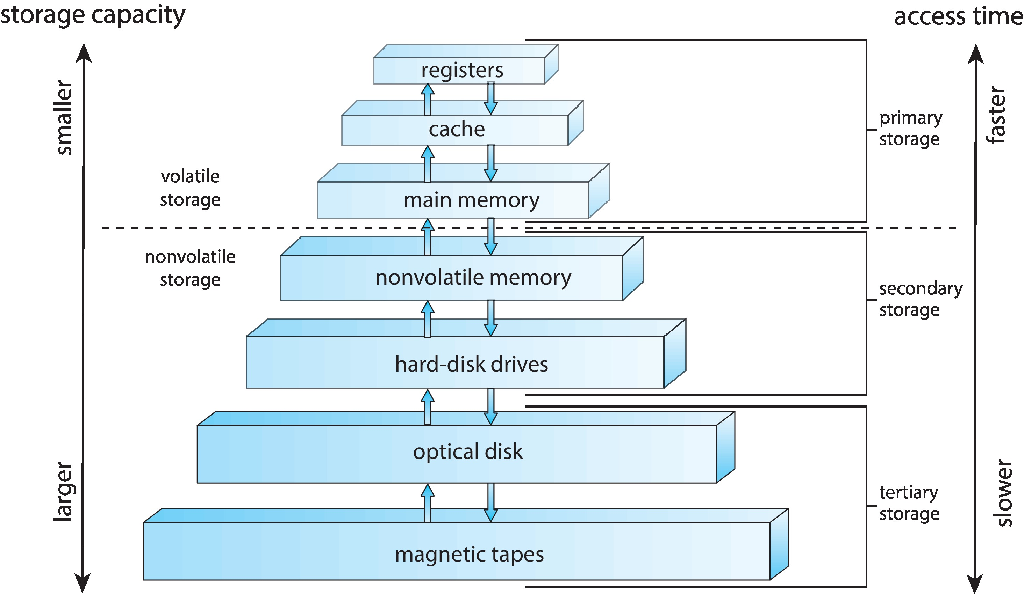
Storage Structure
Main memory – only large storage media that the CPU can access directly
Random access, Volatile, (DRAM)
Secondary storage – extension of main memory that provides large nonvolatile storage capacity
Nonvolatile storage NVS
Mechanical: Hard Disk Drives (HDD)
Electrical: Non-volatile memory (NVM) devices– faster than hard disks, Solid State Drives (SSD)
Storage systems organized in hierarchy
Speed
Cost
Volatility
Caching – copying information into faster storage system; main memory can be viewed as a cache for secondary storage
Device Driver for each device controller to manage I/O (Buffer)

Slide 8
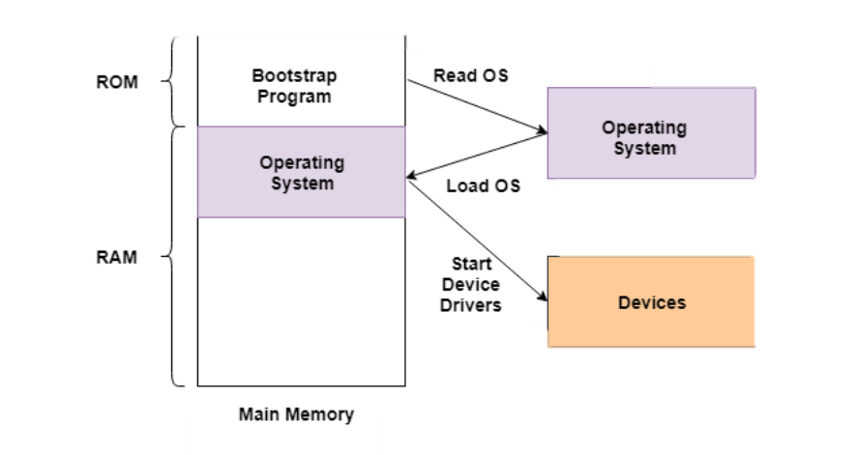

Operating System Operation
“The one program running at all times on the computer” is the kernel
Along with the kernel, there are two other types of programs:
A system program (ships with the operating system)
An application program, all programs not associated with the operating system
Today’s OSes for general purpose and mobile computing also include middleware – a set of software frameworks that provide additional services to application developers such as databases, multimedia, graphics

Slide 9
Cont.
Bootstrap program is loaded at power-up or reboot – initializes all aspects of system
Typically stored in ROM - known as firmware
Loads operating system kernel and starts execution
Start providing services to the system and its users.
System process or daemons run the entire time the kernel is running
Occurrence of an event is signaled by interrupt
Interrupts can be hardware or software

Slide 10
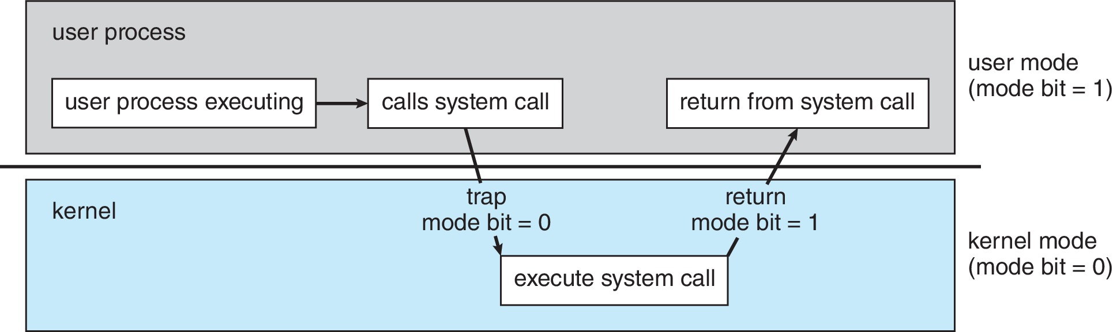
Multiprogramming (Batch system)
Single user cannot always keep CPU and I/O devices busy
Multiprogramming organizes jobs (code and data), so CPU always has one to execute
A subset of total jobs in system is kept in memory
One job selected and run via job scheduling
When job must wait (for I/O for example), OS switches to another job
Dual-mode Operation: operation allows OS to protect itself and other system components
User mode and kernel mode
Mode bit provided by hardware
Provides ability to distinguish when system is running user code or kernel code.
When a user is running  mode bit is “user” (1)
When kernel code is executing  mode bit is “kernel” (0)
How do we guarantee that user does not explicitly set the mode bit to “kernel”?
System call changes mode to kernel, return from call resets it to user
Some instructions designated as privileged, only executable in kernel mode

Slide 11
Process Management Activities
A process is a program in execution.
Program is a passive entity; process is an active entity.
The operating system is responsible for the following activities in connection with process management:
Creating and deleting both user and system processes
Suspending and resuming processes
Providing mechanisms for process synchronization
Providing mechanisms for process communication
Providing mechanisms for deadlock handling

Slide 12
Memory Management
To execute a program all (or part) of the instructions must be in memory
All (or part) of the data that is needed by the program must be in memory
Memory management determines what is in memory and when
Optimizing CPU utilization and computer response to users
Memory management activities
Keeping track of which parts of memory are currently being used and by whom
Deciding which processes and data to move into and out of memory
Allocating and deallocating memory space as needed
Notes:
Cache is a buffer between CPU and main memory , and there is a buffer between main memory (DRAM) and the Secondary Storage
The buffer is a SRAM.

Slide 13
File-system Management
Files usually organized into directories
Access control on most systems to determine who can access what
OS activities include
Creating and deleting files and directories
Primitives to manipulate files and directories
Mapping files onto secondary storage
Backup files onto stable (non-volatile) storage media
Mass-Storage Management:
Usually, disks used to store data that does not fit in main memory or data that must be kept for a “long” period of time
OS activities
Mounting and unmounting
Free-space management
Storage allocation
Disk scheduling
Partitioning
Protection

Slide 14
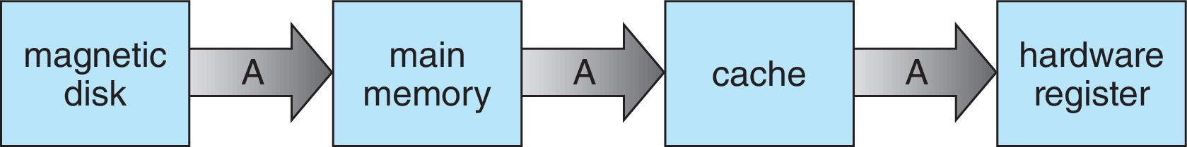
Caching
Important principle, performed at many levels in a computer (in hardware, operating system, software)
data in use copied from slower to faster storage temporarily
Faster storage (cache) checked first to determine if data is there
If it is, data used directly from the cache (fast)
If not, data copied to cache and used there
Cache smaller than storage being cached
Cache management important design problem
Cache size and replacement policy
Migration of data “A” from Disk to Register

Slide 15
I/O Subsystem
I/O subsystem responsible for
Memory management of I/O including buffering (storing data temporarily while it is being transferred), caching (storing parts of data in faster storage for performance), spooling (the overlapping of output of one job with input of other jobs)
General device-driver interface
Drivers for specific hardware devices

Slide 16
Protection and Security
Protection – any mechanism for controlling access of processes or users to resources defined by the OS
Security – defense of the system against internal and external attacks
Huge range, including denial-of-service, worms, viruses, identity theft, theft of service
Systems generally first distinguish among users, to determine who can do what
User identities (user IDs, security IDs) include name and associated number, one per user
User ID then associated with all files, processes of that user to determine access control
Group identifier (group ID) allows set of users to be defined and controls managed, then also associated with each process, file

Slide 17
Operating System Services
user interface: GUI, CLI or batch.
program execution: provide a suitable environment to run any program.
I/O operation: help you using input and output devices.
file system manipulation: create and delete files and search them.
communication: communication via shared memory or over network.
error detection : tell me all information about any error occur.
Resource allocation: provide the resources needed for each program.
Accounting : To keep track of which users use how much and what kinds of computer resources
Protect and security : The owners of information stored in a multiuser or networked computer system may want to control use of that information, concurrent processes should not interfere with each other

Slide 18
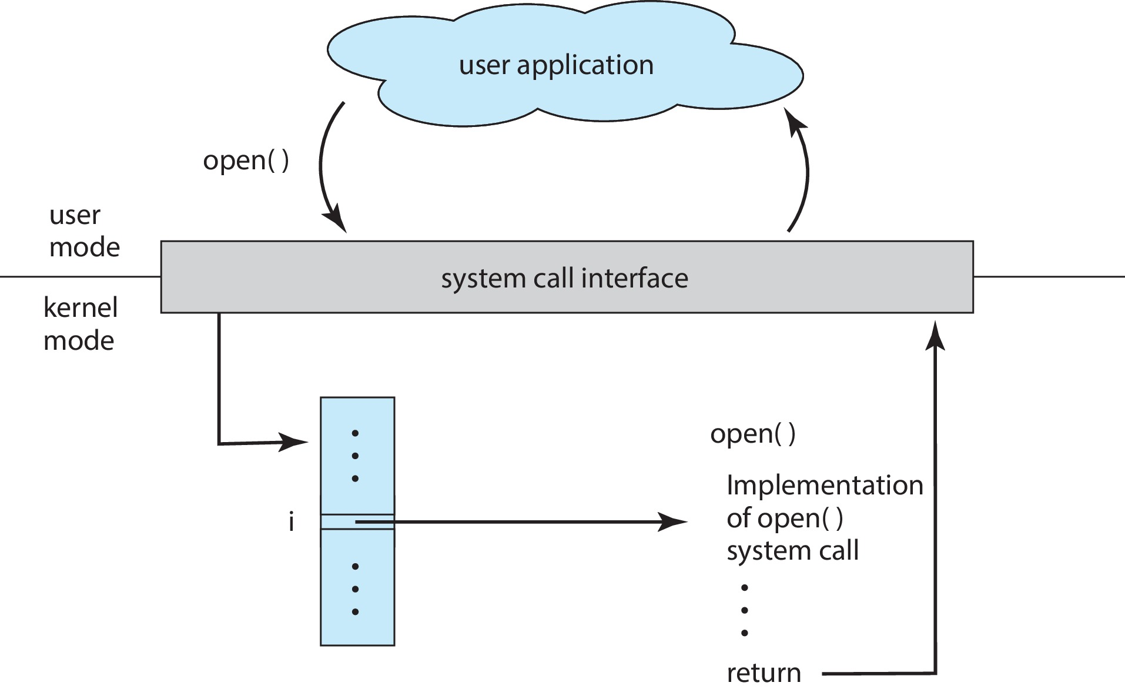
System Calls
Programming interface to the services provided by the OS
Types of System Calls
Process control
File management
Device management
Information maintenance
Communications
Protection

Slide 19
System Programs
System programs provide a convenient environment for program development and execution.
They can be divided into:
File manipulation
Status information sometimes stored in a file
Programming language support
Program loading and execution
Communications
Background services
Application programs
Most users’ view of the operating system is defined by system programs, not the actual system calls; others are considerably more complex

Slide 20
System Programs (Cont.)
File management - Create, delete, copy, rename, print, list, and generally manipulate files and directories
Status information
Some ask the system for info - date, time, amount of available memory, disk space, number of users
Some systems implement a registry - used to store and retrieve configuration information
File modification : Text editors to create and modify files
Programming-language support - Compilers, assemblers, debuggers and interpreters sometimes provided
Program loading and execution- loaders, debugging systems for higher-level and machine language
Communications - Provide the mechanism for creating virtual connections among processes, users, and computer systems
Background Services
Launch at boot time
Some for system-startup, then terminate
Some from system boot to shutdown
Provide facilities like disk checking, process scheduling, error logging, printing
Run in user context not kernel context
Known as services, subsystems, daemons
Application programs
Run by users
Not typically considered part of OS

Slide 21
System Boot
When power initialized on system, execution starts at a fixed memory location
Operating system must be made available to hardware so hardware can start it
Small piece of code – bootstrap loader, BIOS, stored in ROM or EEPROM locates the kernel, loads it into memory, and starts it
Sometimes two-step process where boot block at fixed location loaded by ROM code, which loads bootstrap loader from disk
Modern systems replace BIOS with Unified Extensible Firmware Interface (UEFI)
Common bootstrap loader, GRUB, allows selection of kernel from multiple disks, versions, kernel options
Kernel loads and system is then running
Boot loaders frequently allow various boot states, such as single user mode

Slide 22
Operating-System Debugging
Debugging is finding and fixing errors, or bugs
Also, performance tuning
OS generate log files containing error information
Failure of an application can generate core dump file capturing memory of the process
Operating system failure can generate crash dump file containing kernel memory
Beyond crashes, performance tuning can optimize system performance
Sometimes using trace listings of activities, recorded for analysis
Profiling is periodic sampling of instruction pointer to look for statistical trends
Kernighan’s Law: “Debugging is twice as hard as writing the code in the first place. Therefore, if you write the code as cleverly as possible, you are, by definition, not smart enough to debug it.”

Slide 23
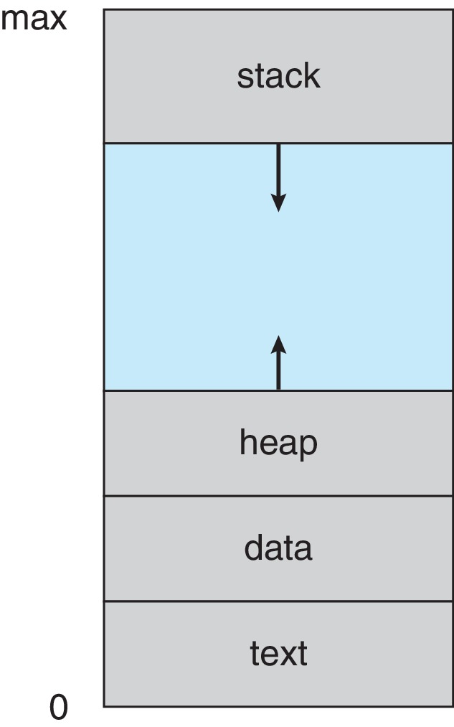
Process Concept
Process – a program in execution; process execution must progress in sequential fashion.
Program is passive entity stored on disk (executable file); process is active
Program becomes process when an executable file is loaded into memory
One program can be several processes
Consider multiple users executing the same program
Process in Memory
The program code, also called text section
Data section containing global variables
Heap containing memory dynamically allocated during run time
Stack containing temporary data
Function parameters, return addresses, local variables
Current activity including program counter, processor registers

Slide 24
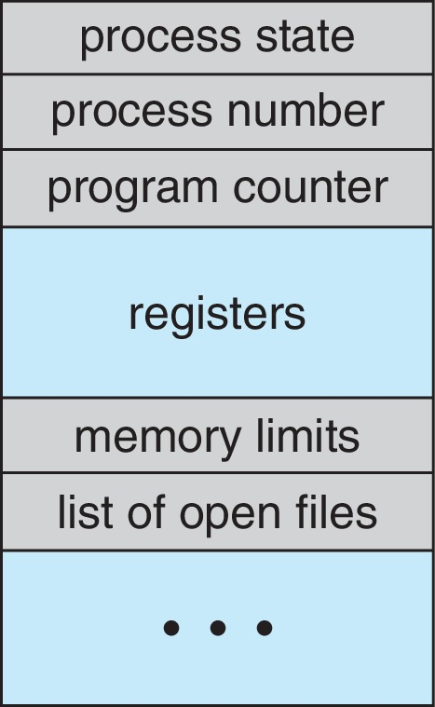
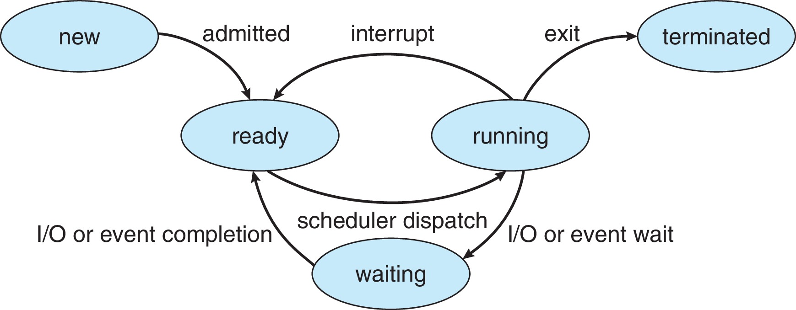
Process Control Block (PCB)
Some call it the Task Control Block while others call it Process Table
Information associated with each process :
Process state As a process executes, it changes state
New: The process is being created
Running: Instructions are being executed
Waiting: The process is waiting for some event to occur
Ready: The process is waiting to be assigned to a processor
Terminated: The process has finished execution
Program counter – location of instruction to next execute
CPU registers – contents of all process-centric registers
CPU scheduling information- priorities, scheduling queue pointers
Memory-management information – memory allocated to the process
Accounting information – CPU used, clock time elapsed since start, time limits
I/O status information – I/O devices allocated to process, list of open files

Slide 25
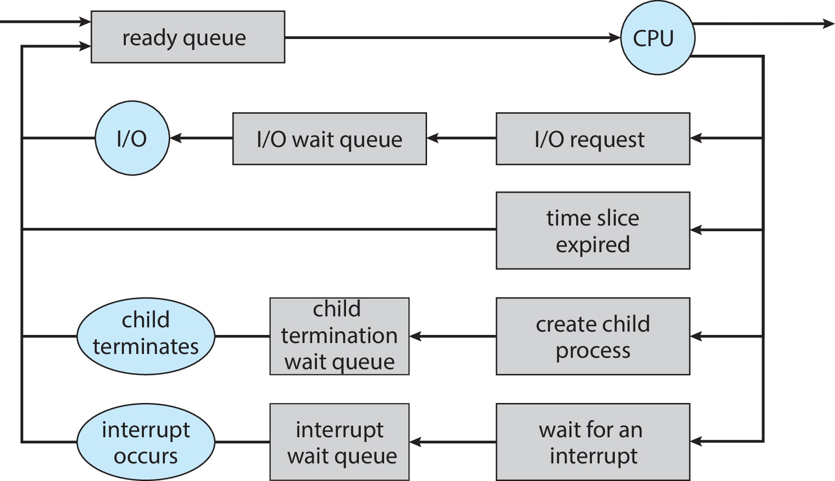
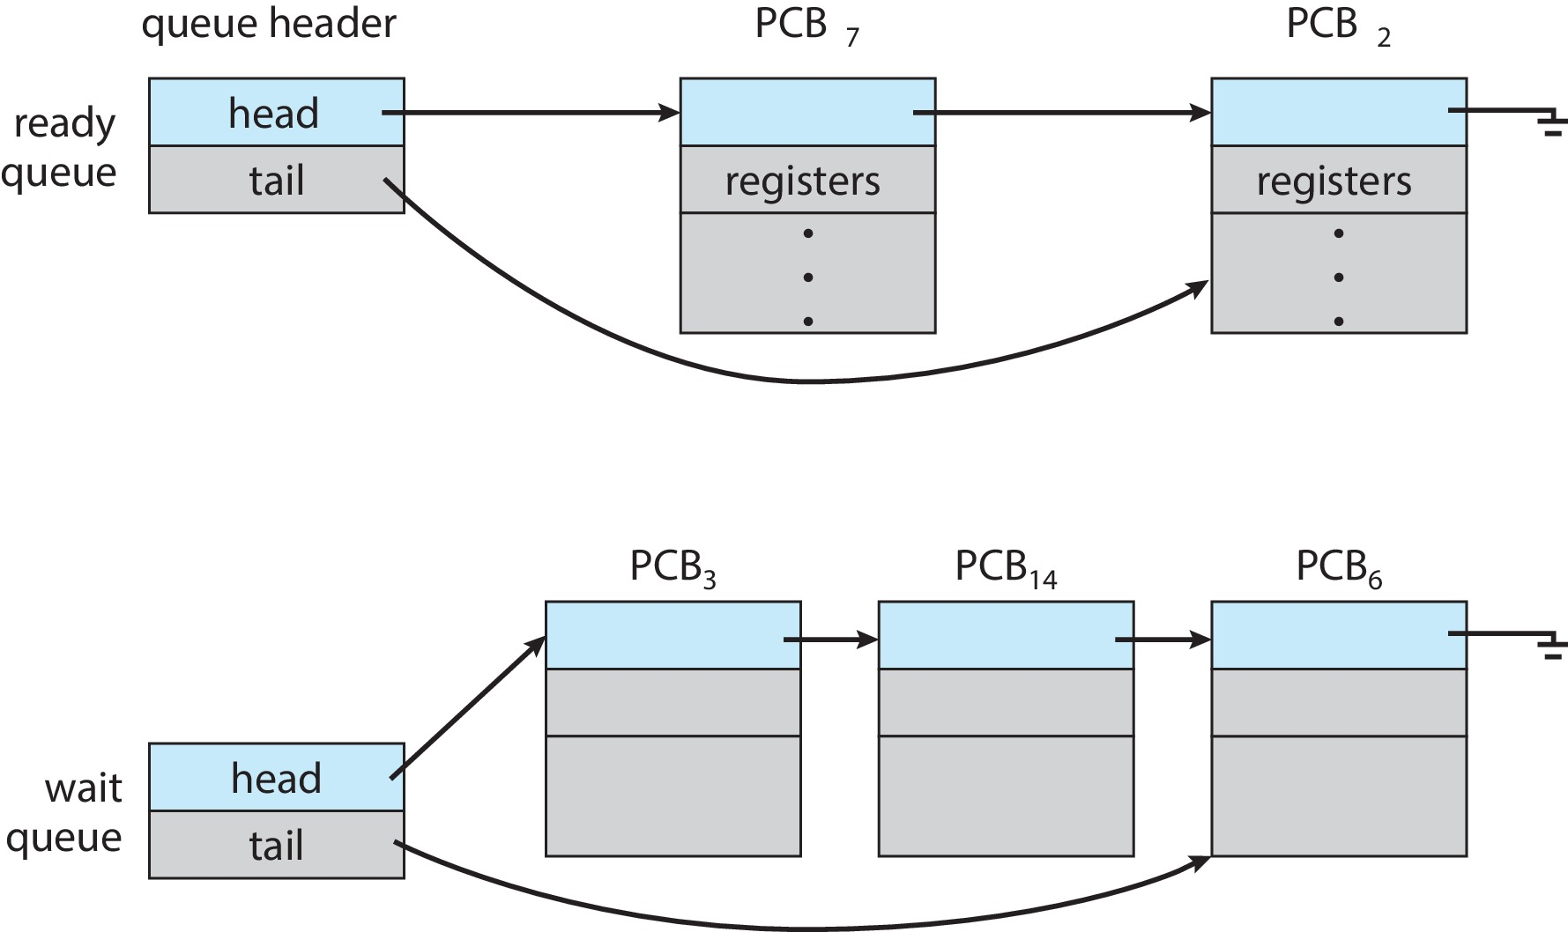
Process Scheduling
Process scheduler selects among available processes for next execution on CPU core
Goal -- Maximize CPU use, quickly switch processes onto CPU core
Maintains scheduling queues of processes
Ready queue – set of all processes residing in main memory, ready and waiting to execute
Wait queues – set of processes waiting for an event (i.e., I/O)
Processes migrate among the various queues

Slide 26
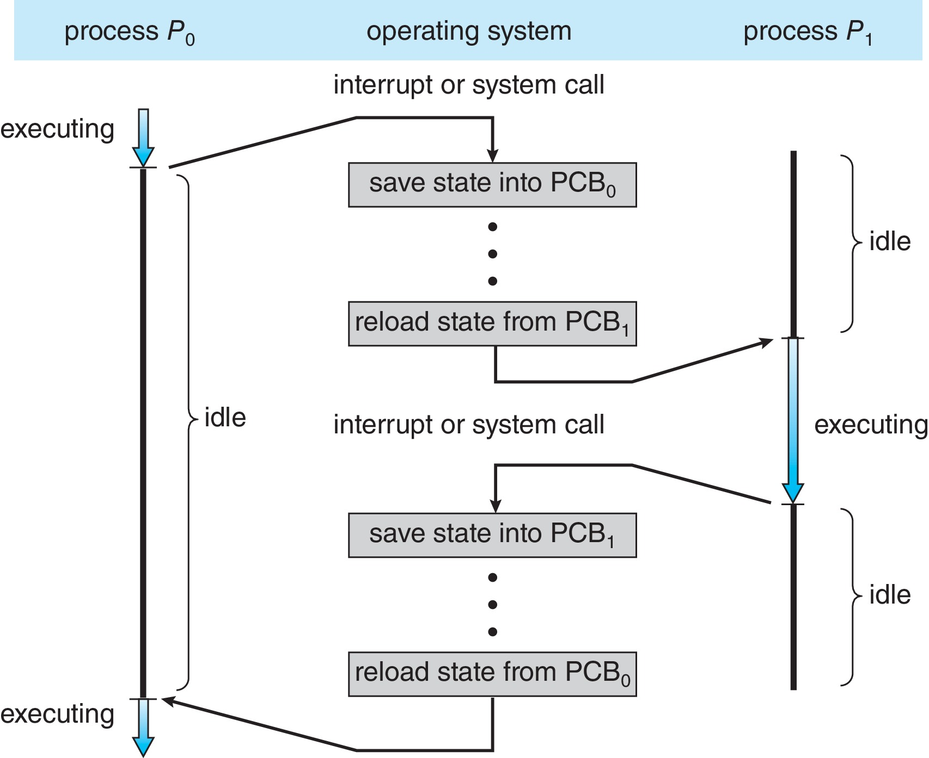
Context Switch
When CPU switches to another process, the system must save the state of the old process and load the saved state for the new process via a context switch
Context of a process represented in the PCB
Context-switch time is pure overhead; the system does no useful work while switching
The more complex the OS and the PCB ➔ the longer the context switch
Time dependent on hardware support
Some hardware provides multiple sets of registers per CPU ➔ multiple contexts loaded at once

Slide 27
Operations on Processes
Process Creation:
Parent process create children processes, which, in turn create other processes, forming a tree of processes
Generally, process identified and managed via a process identifier (pid)
Resource sharing options
Parent and children share all resources
Children share subset of parent’s resources
Parent and child share no resources
Execution options
Parent and children execute concurrently
Parent waits until children terminate
Address space
Child duplicate of parent
Child has a program loaded into it
UNIX examples
fork() system call creates new process
exec() system call used after a fork() to replace the process’ memory space with a new program
Parent process calls wait()waiting for the child to terminate

Slide 28
Cont. Operations on Processes
Process Termination:
Process executes last statement and then asks the operating system to delete it using the exit() system call.
Returns status data from child to parent (via wait())
Process’ resources are deallocated by operating system
Parent may terminate the execution of children processes using the abort() system call. Some reasons for doing so:
Child has exceeded allocated resources
Task assigned to child is no longer required
The parent is exiting, and the operating systems does not allow a child to continue if its parent terminates
Some operating systems do not allow child to exists if its parent has terminated. If a process terminates, then all its children must also be terminated.
cascading termination. All children, grandchildren, etc., are terminated.
The termination is initiated by the operating system.
The parent process may wait for termination of a child process by using the wait()system call. The call returns status information and the pid of the terminated process
pid = wait(&status);
If no parent waiting (did not invoke wait()) process is a zombie
If parent terminated without invoking wait(), process is an orphan
Notes:
An orphan process is a computer process whose parent process has finished or terminated, though it (child process) remains running itself.
A zombie process or defunct process is a process that has completed execution but still has an entry in the process table as its parent process didn't invoke an wait() system call.

Slide 29
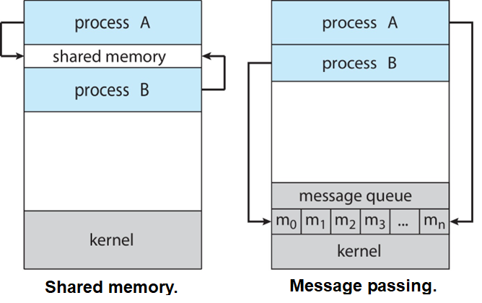
Interprocess Communication
Processes within a system may be independent or cooperating
Cooperating process can affect or be affected by other processes, including sharing data
Reasons for cooperating processes:
Information sharing
Computation speedup
Modularity
Convenience
Cooperating processes need interprocess communication (IPC)
models of IPC
Shared memory : An area of memory shared among the processes that wish to communicate , the control is under the process not the OS.
Message passing :Mechanism for processes to communicate and to synchronize their actions
Pipes

Slide 30
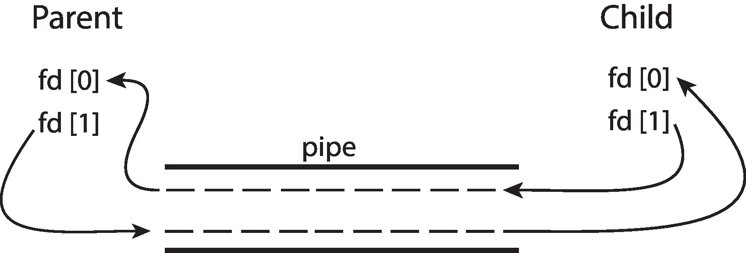
Pipes
Acts as a conduit allowing two processes to communicate
Ordinary pipes – cannot be accessed from outside the process that created it. Typically, a parent process creates a pipe and uses it to communicate with a child process that it created.
Ordinary Pipes allow communication in standard producer-consumer style
Producer writes to one end (the write-end of the pipe)
Consumer reads from the other end (the read-end of the pipe)
Ordinary pipes are therefore unidirectional
Require parent-child relationship between communicating processes
Named pipes – can be accessed without a parent-child relationship.
Named Pipes are more powerful than ordinary pipes
Communication is bidirectional
No parent-child relationship is necessary between the communicating processes
Several processes can use the named pipe for communication
Provided on both UNIX and Windows systems

Slide 31
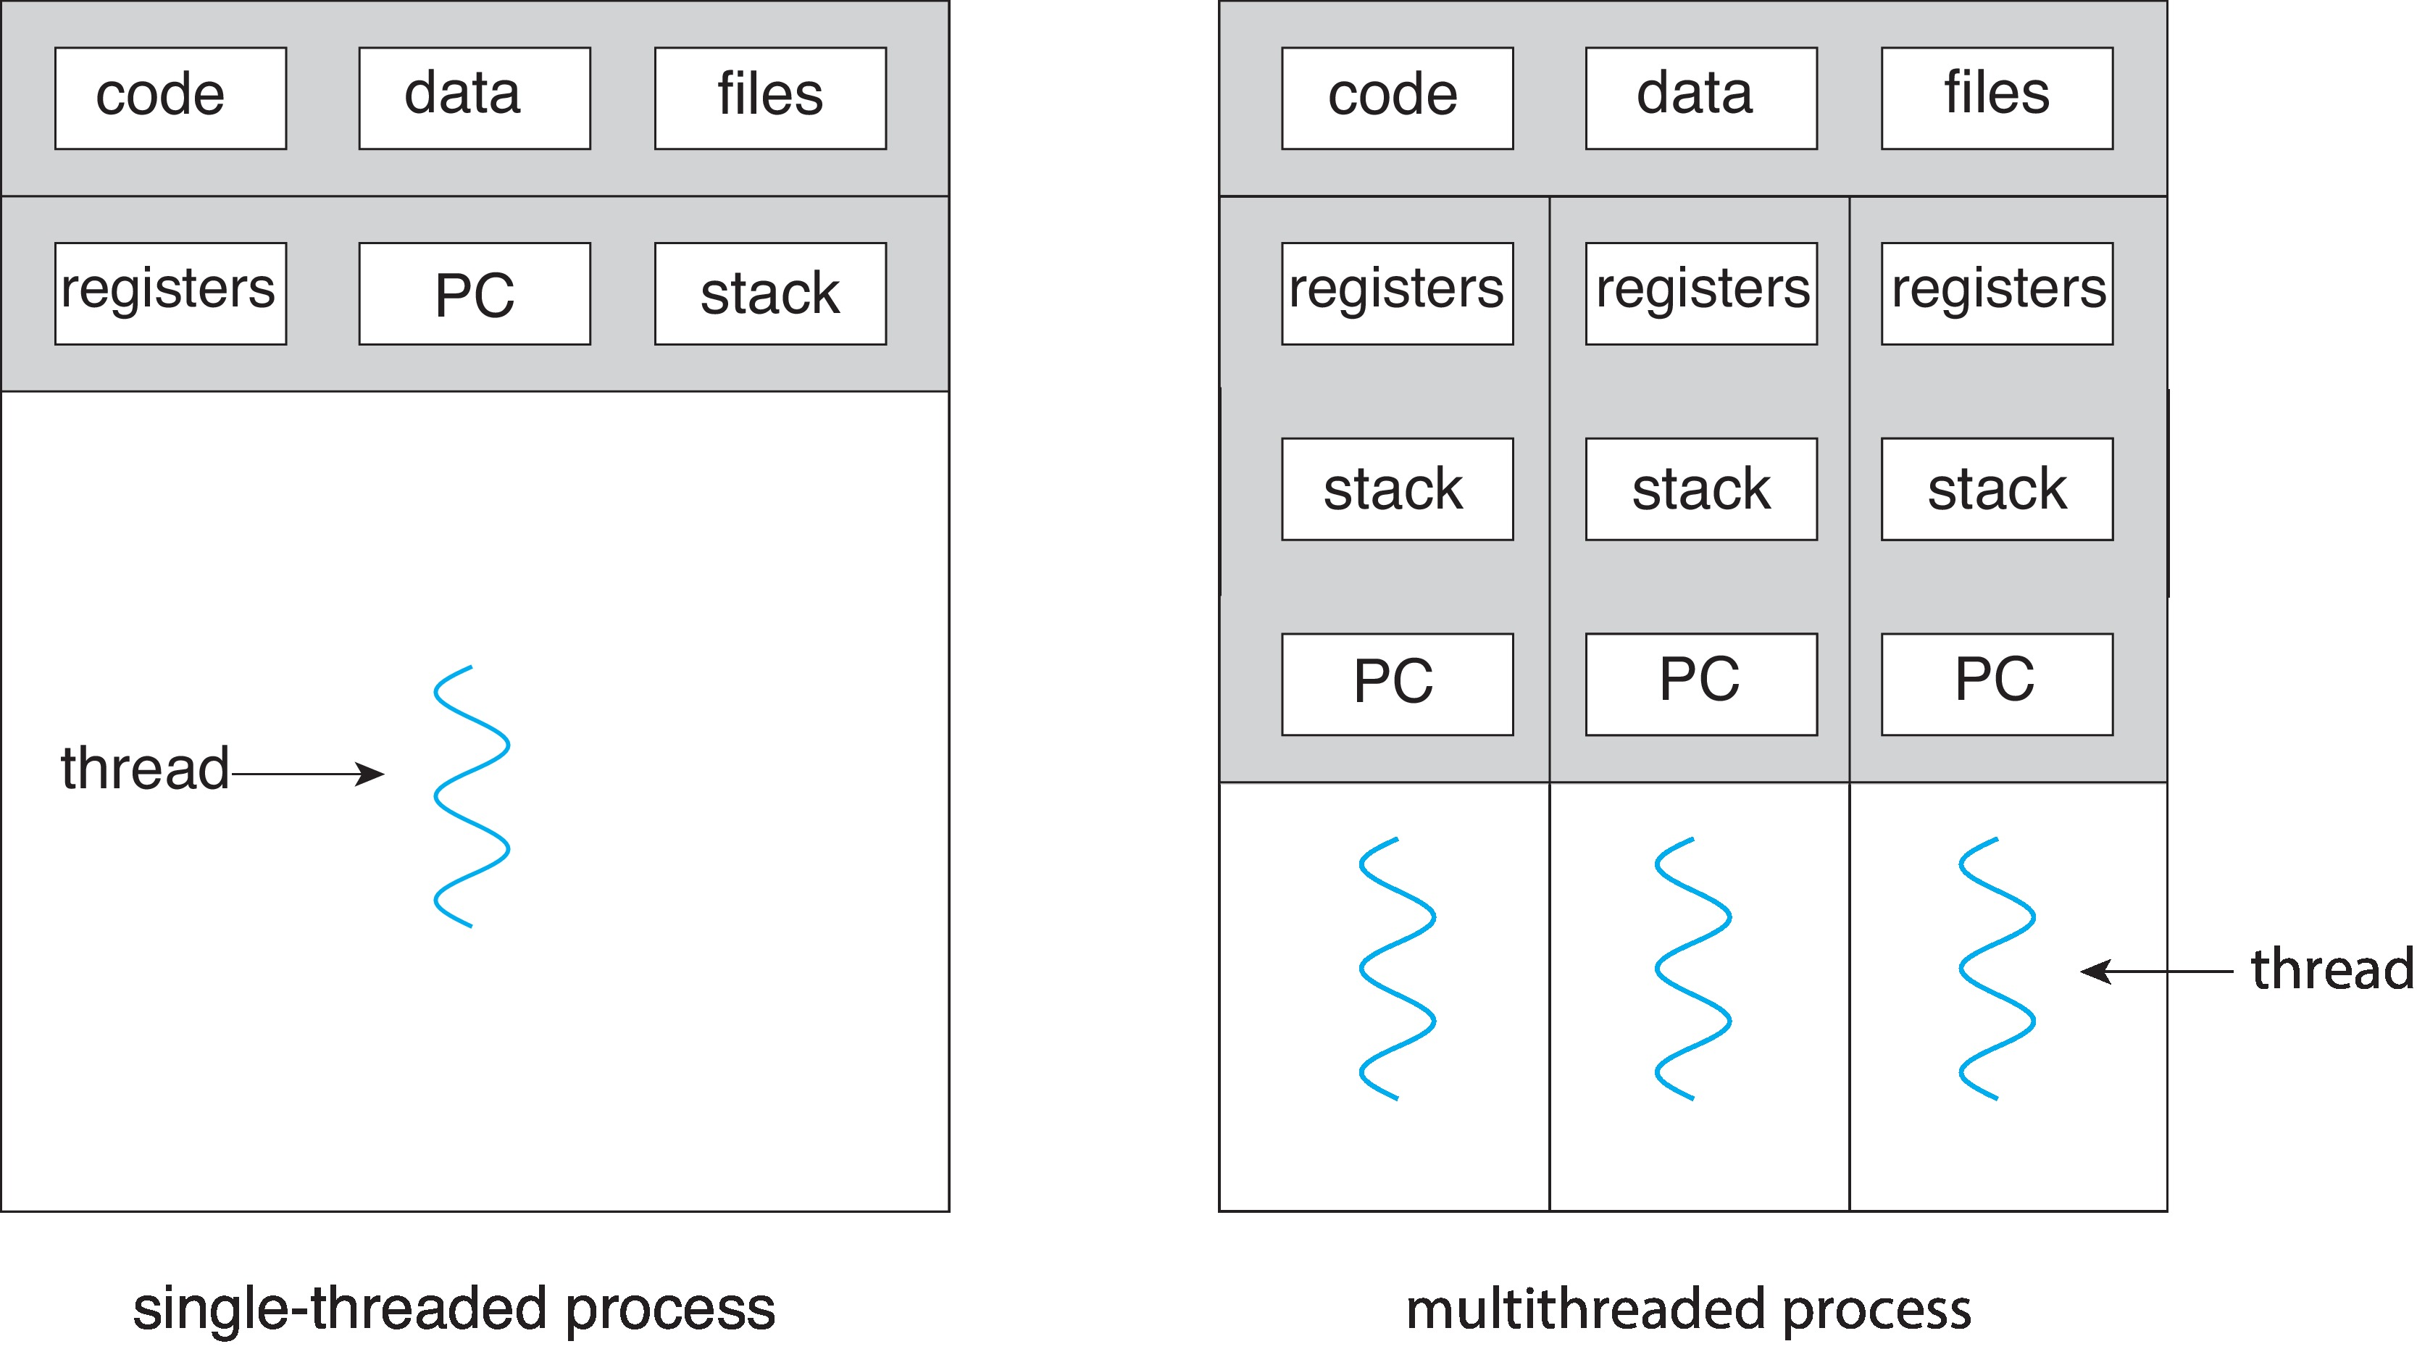
Threads
Thread means segment of a process (lightweight process)
Multiple tasks with the application can be implemented by separate threads
Traditionally, a process has a single thread of control, but most modern applications are multithreaded
Can simplify code, increase efficiency
A thread comprises a thread ID, a program counter (PC), a register set, and a stack.
It shares with other threads belonging to the same process its code section, data section, opened files
Key Benefits of Threads:
Takes less time to create a new thread than a process
Less time to terminate a thread than a process
Switching between two threads takes less time than switching between processes
Threads enhance efficiency in communication between programs

Slide 32
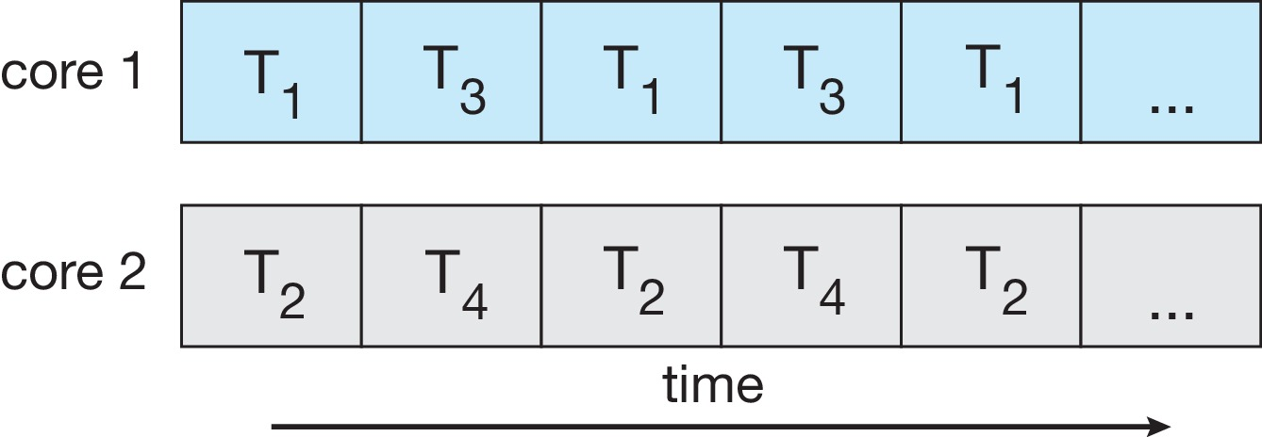
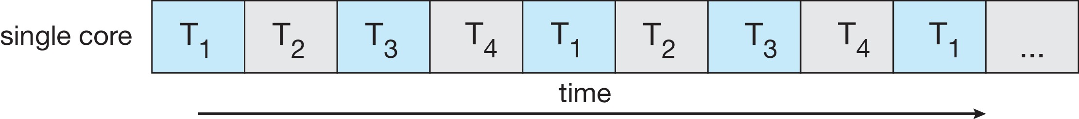
Multicore Programming
Multicore vs. Multiprocessor systems
The multicore refers to a single CPU with multiple execution units while the multiprocessor refers to a system that has two or more CPUs.
Multicore or multiprocessor systems puts pressure on programmers, challenges include:
Dividing activities
Balance
Data splitting
Data dependency
Testing and debugging
Parallelism implies a system can perform more than one task simultaneously
Concurrency supports more than one task making progress
Single processor / core, scheduler providing concurrency
Concurrency
Parallelism

Slide 33
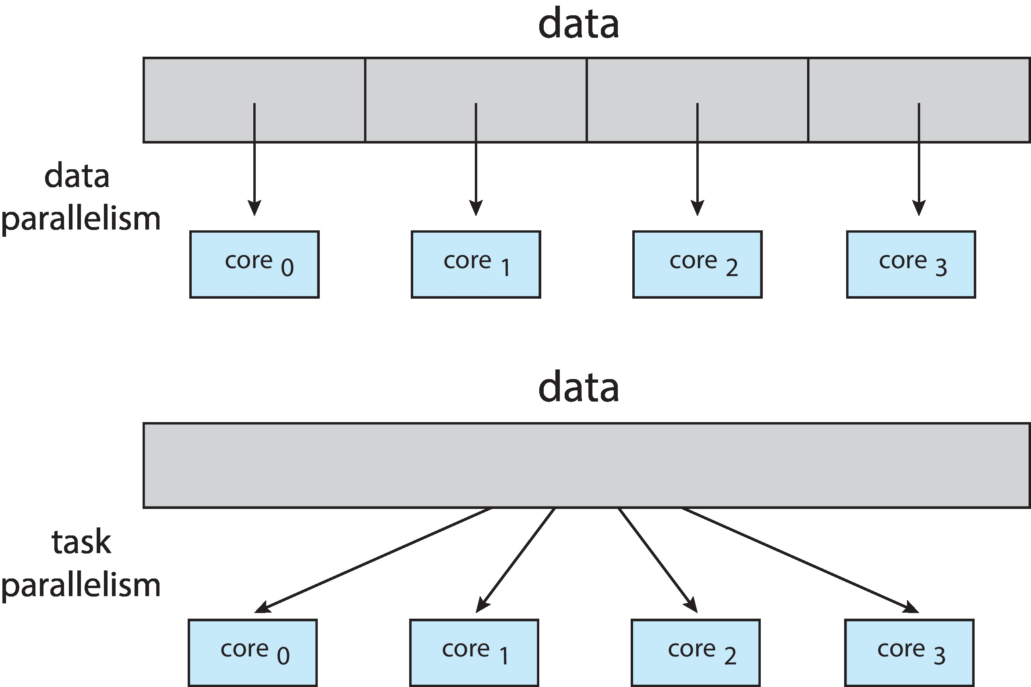
Types of parallelism
Data parallelism – distributes subsets of the same data across multiple cores, same operation on each
Task parallelism – distributing threads across cores, each thread performing unique operation

Slide 34
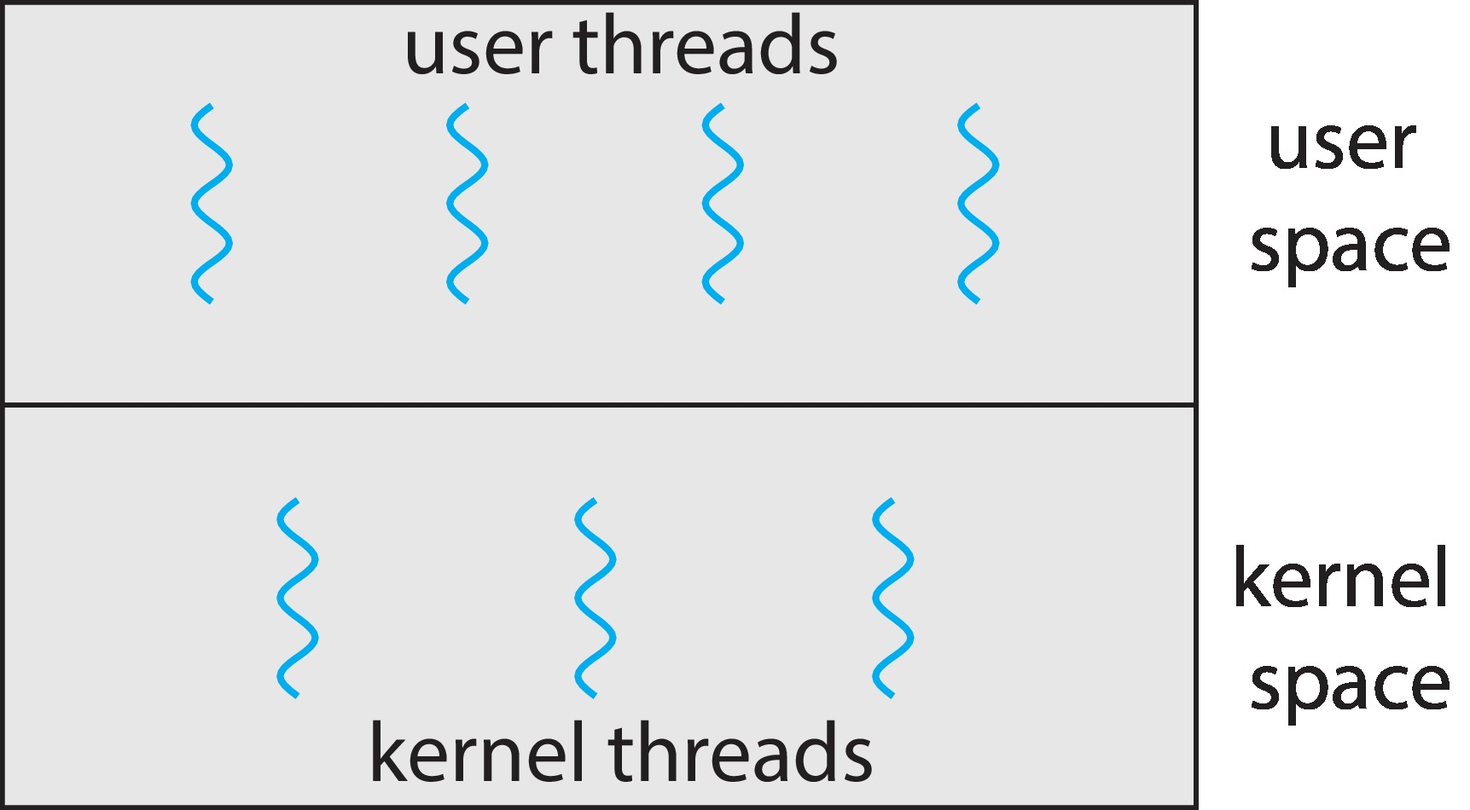
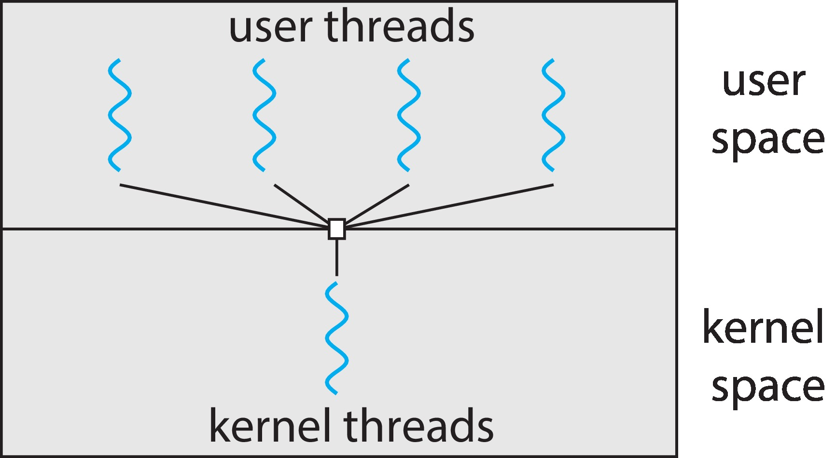
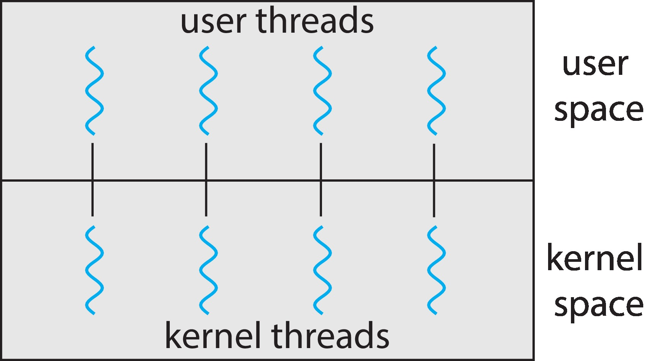
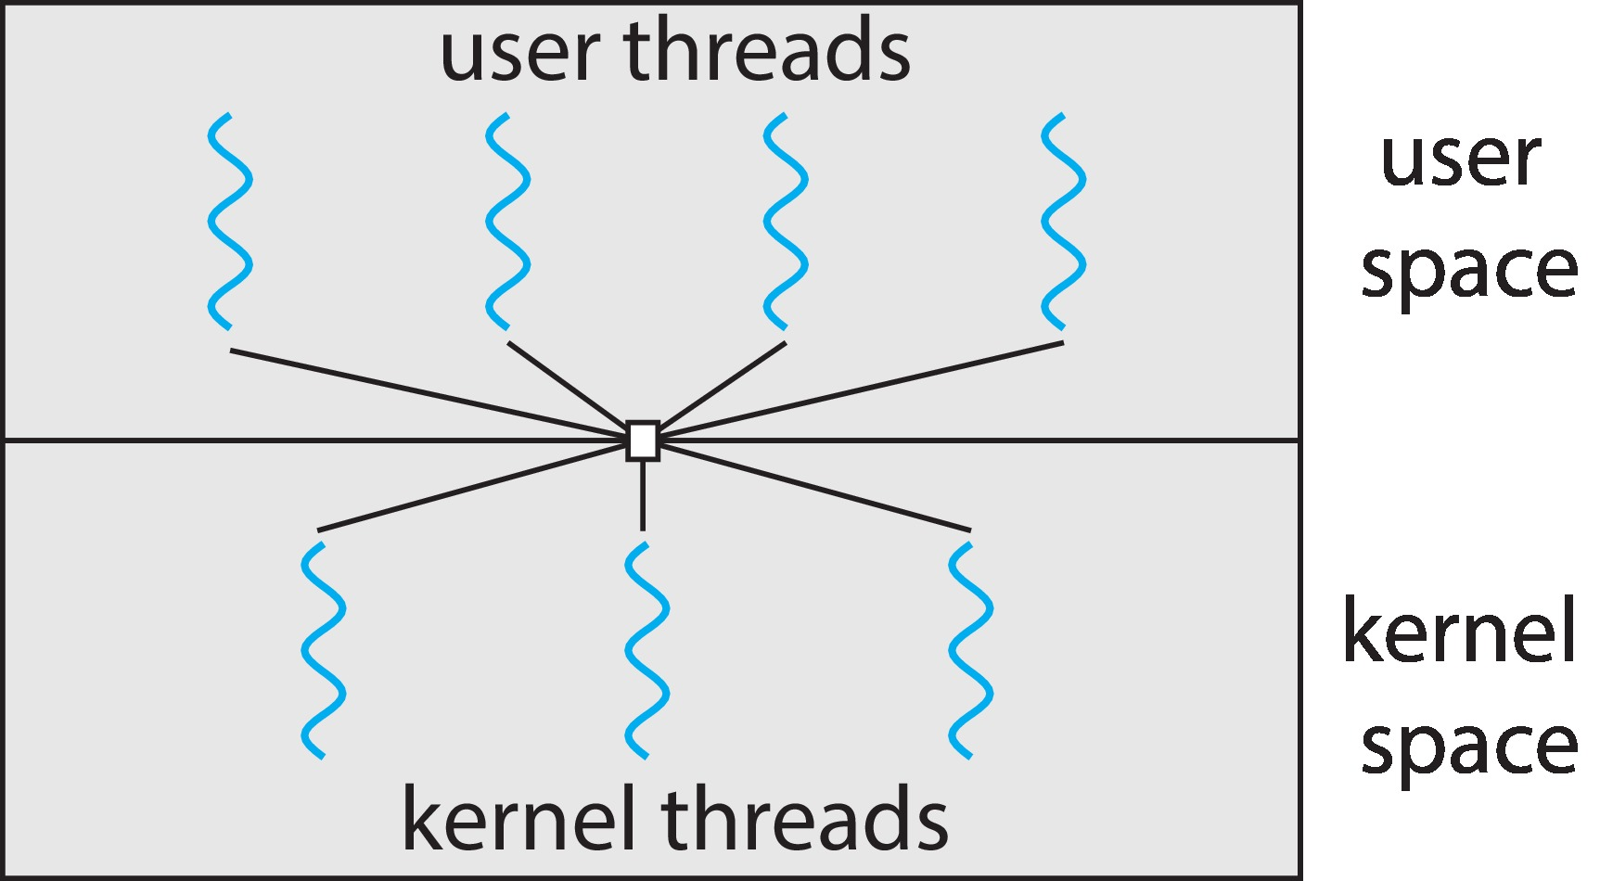
Types of Threads
User Level Thread (ULT) : management done by user-level threads library
Kernel level Thread (KLT) : Supported by the Kernel
Multithreading Models:
Many-to-One :Many user level threads are mapped to one kernel level thread
One-to-One: Each user level thread is mapped to one kernel level thread
Many-to-Many : Many user level threads are mapped to many kernel level threads
Many-to-One
One-to-One
Many-to-Many

Slide 35
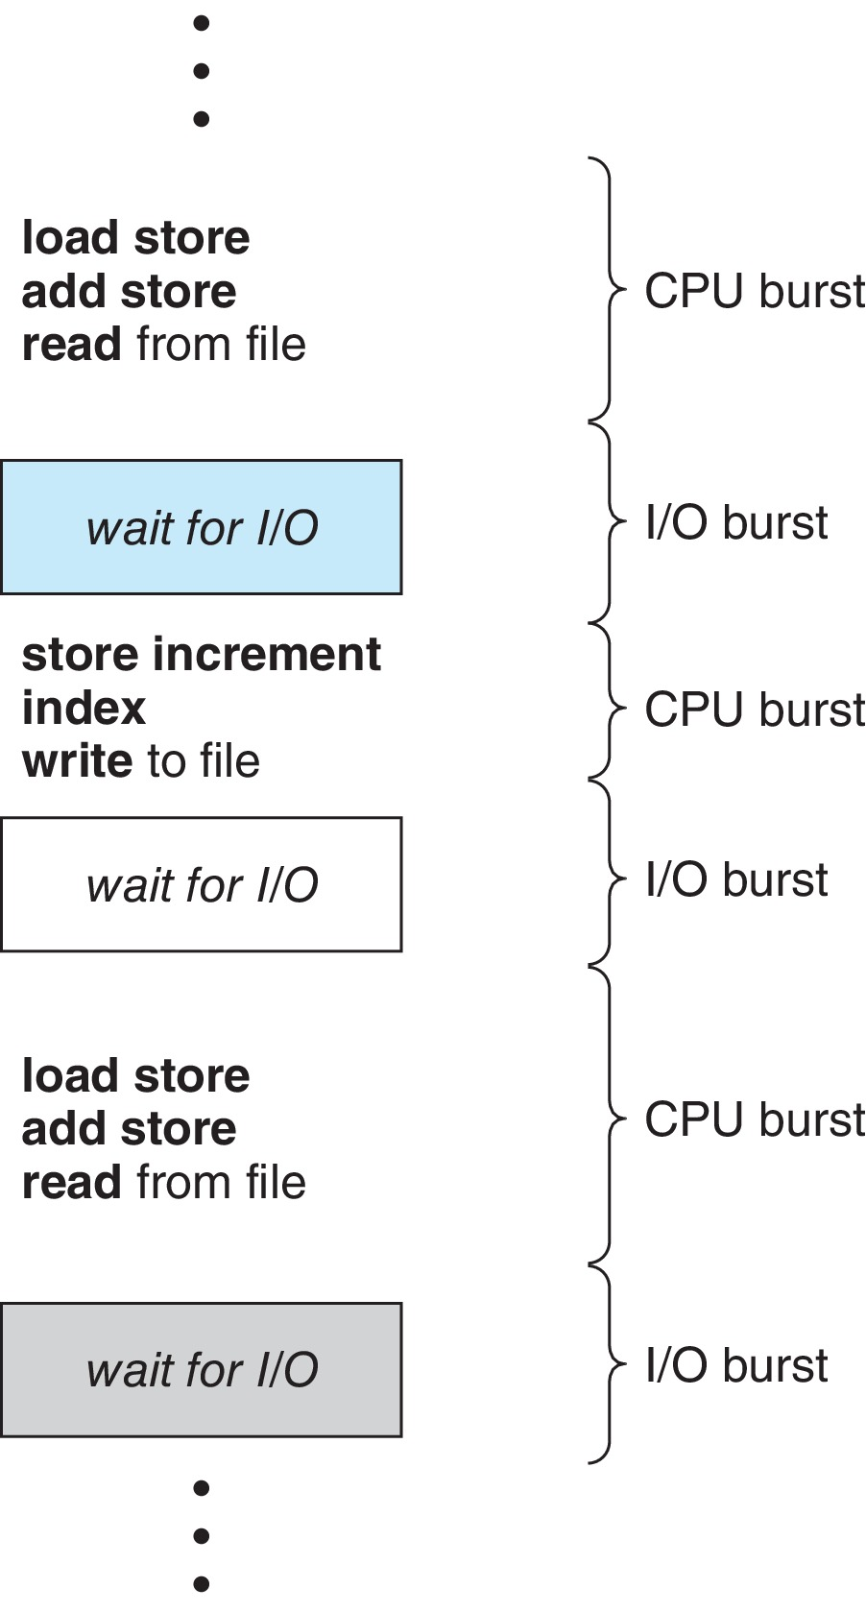
CPU Scheduling
In a system with a single CPU core, only one process can run at a time. Others must wait until the CPU’s core is free and can be rescheduled
The objective of multiprogramming is to have some process running at all times, to maximize CPU utilization
By switching the CPU among processes, the operating system can make the computer more productive
Process execution consists of a cycle of CPU execution and I/O wait
CPU burst followed by I/O burst, which is followed by another CPU burst, then another I/O burst, and so on.
Every time one process has to wait, another process can use of the CPU.
The CPU scheduler selects from among the processes in ready queue, and allocates a CPU core to one of them
CPU scheduling decisions may take place when a process:
1. Switches from running to waiting state (I/O request, wait for the child)
2. Switches from running to ready state (interrupt occurs)
3. Switches from waiting to ready (completion of I/O)
4. Terminates

Slide 36
Preemptive and Nonpreemptive Scheduling
When scheduling takes place only under circumstances 1 and 4, the scheduling scheme is nonpreemptive. Otherwise, it is preemptive.
Under Nonpreemptive scheduling, once the CPU has been allocated to a process, the process keeps the CPU until it releases it either by terminating or by switching to the waiting state.
Preemptive Scheduling and Race Conditions:
Preemptive scheduling can result in race conditions when data are shared among several processes.
Consider the case of two processes that share data. While one process is updating the data, it is preempted so that the second process can run. The second process then tries to read the data, which are in an inconsistent state.

Slide 37
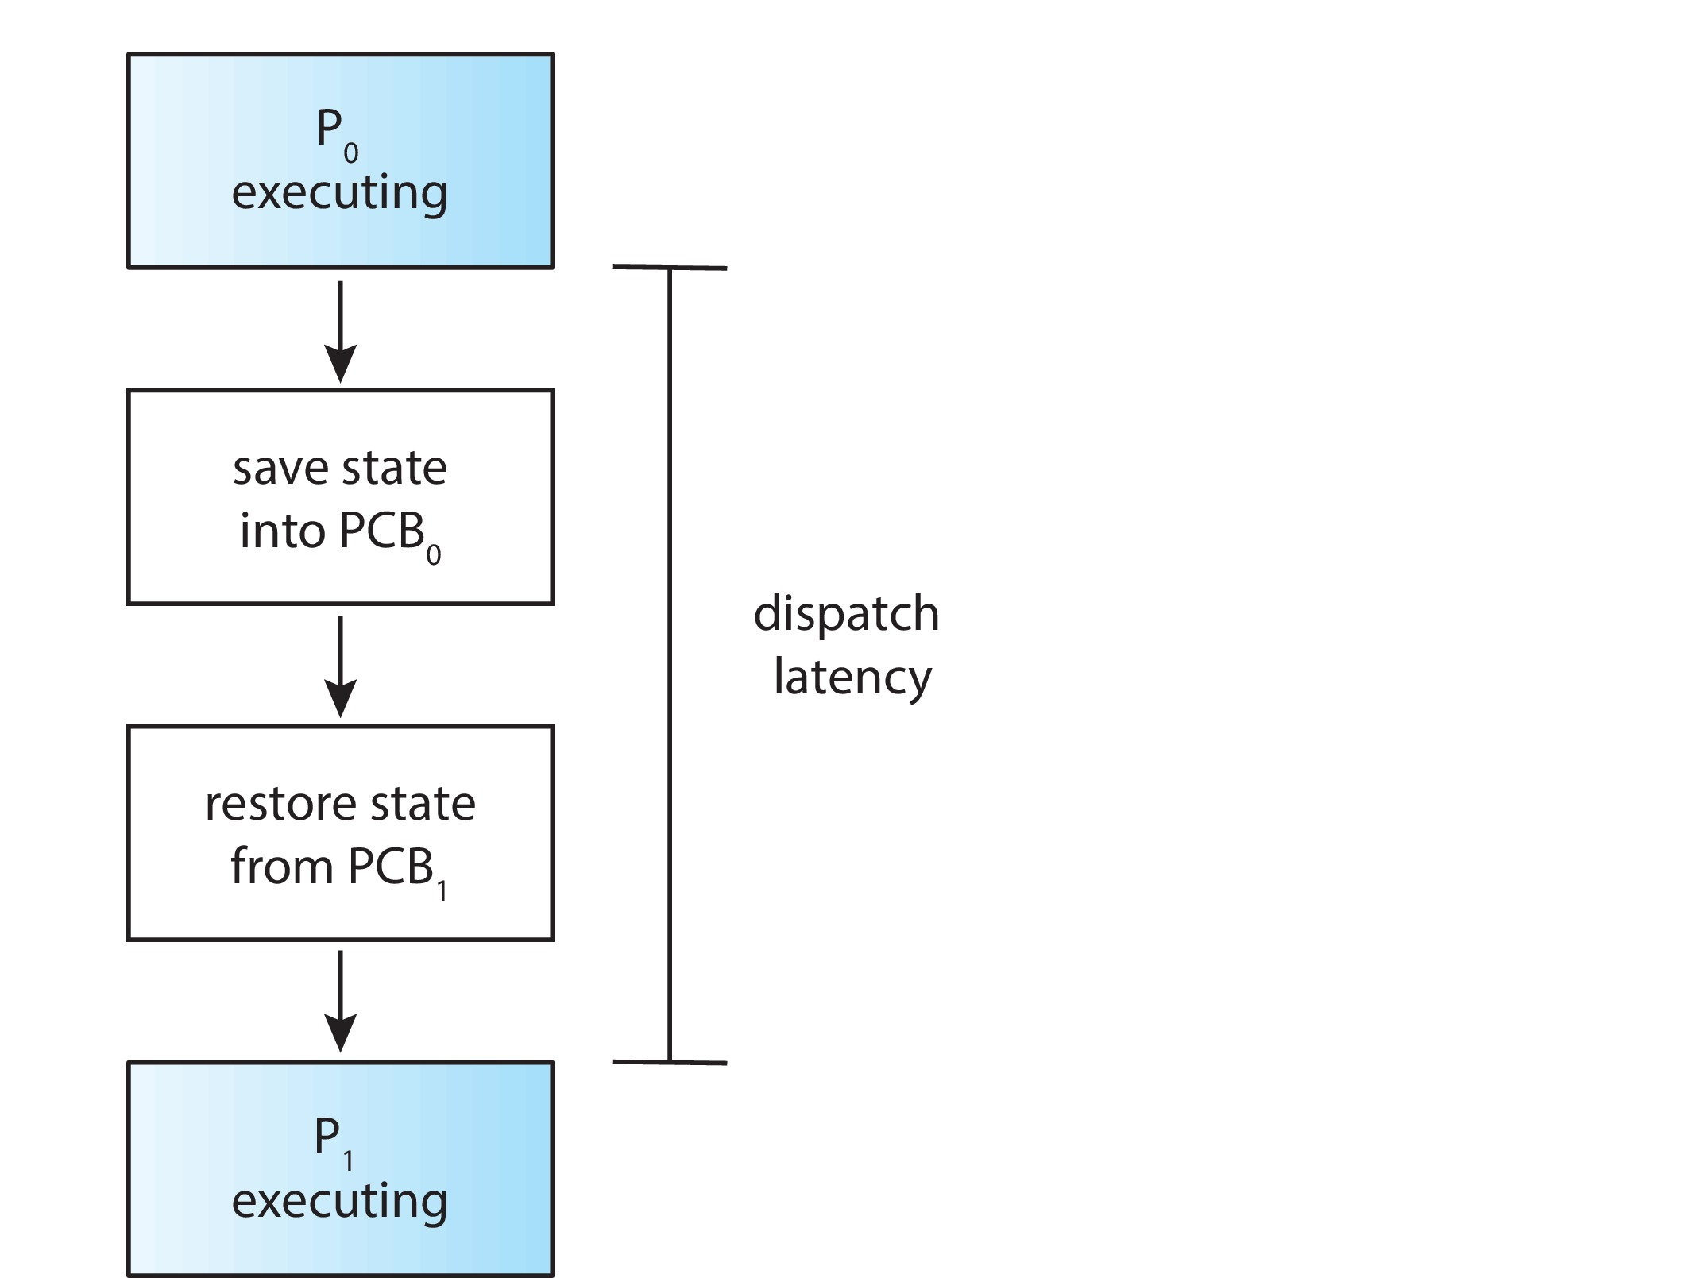
Dispatcher
Dispatcher module gives control of the CPU to the process selected by the CPU scheduler; this involves:
Switching context
Switching to user mode
Jumping to the proper location in the user program to restart that program
Dispatch latency – time it takes for the dispatcher to stop one process and start another running

Slide 38
Scheduling Criteria
CPU utilization – keep the CPU as busy as possible
Throughput – # of processes that complete their execution per time unit
Arrival Time: Time at which the process arrives in the ready queue.
Response time – amount of time it takes from when a request was submitted until the first response is produced.
Burst Time: Time required by a process for CPU execution.
Turn Around Time: Time Difference between completion time and arrival time.
Turn Around Time = Completion Time – Arrival Time
Waiting time – amount of time a process has been waiting in the ready queue or (Time Difference between turn around time and burst time). Waiting Time = Turn Around Time – Burst Time
Completion Time: Time at which process completes its execution.

Slide 39
Scheduling Algorithm
Optimization Criteria:
Max CPU utilization
Max throughput
Min turnaround time
Min waiting time
Min response time
Scheduling Algorithms for a single processing core:
First Come, First Served (FCFS)
Shortest-Job-First (SJF)
Shortest Remaining Time
Round Robin (RR)
Priority Scheduling
Multilevel Queue Scheduling

Slide 40
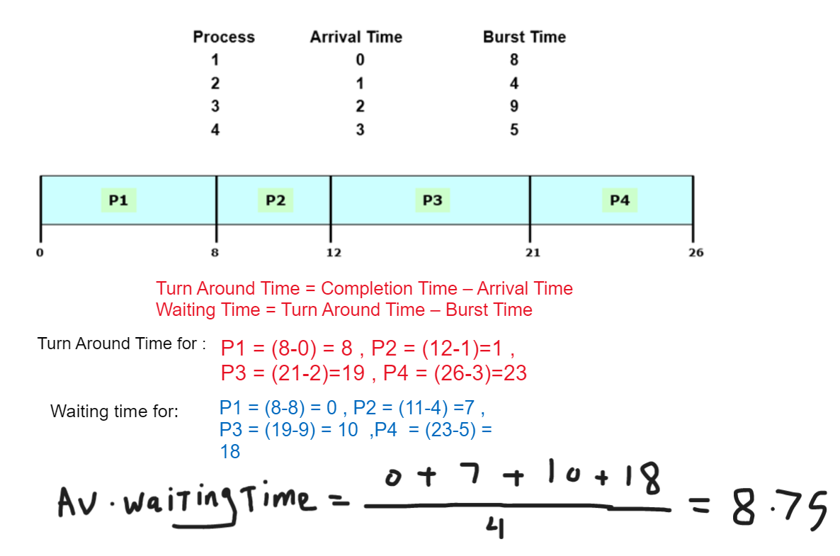
First- Come, First-Served (FCFS) Scheduling:
Note that the FCFS scheduling algorithm is non-preemptive. Once the CPU has been allocated to a process, that process keeps the CPU until it releases the CPU, either by terminating or by requesting I/O.
Notes:
Convoy effect - short process behind long process
All the other processes wait for the one big process to get off the CPU
Results in lower CPU and device utilization than might be possible if the shorter processes were allowed to go first

Slide 41
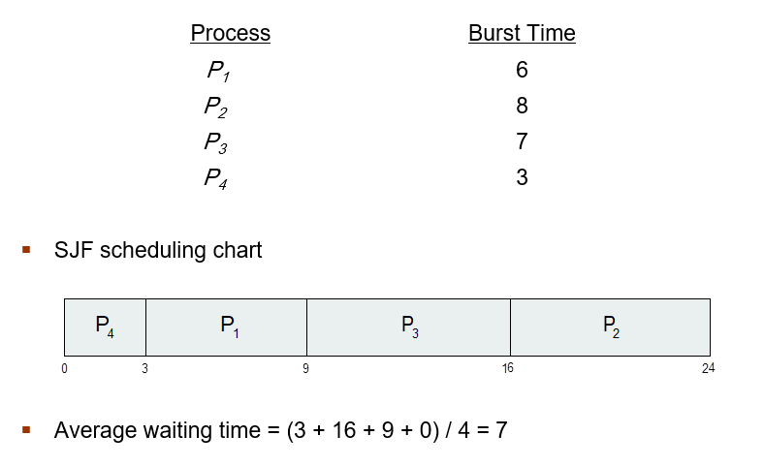
Shortest-Job-First (SJF) Scheduling
Associate with each process the length of its next CPU burst
Use these lengths to schedule the process with the shortest time
SJF is optimal – gives minimum average waiting time for a given set of processes
Preemptive version called shortest-remaining-time-first

Slide 42
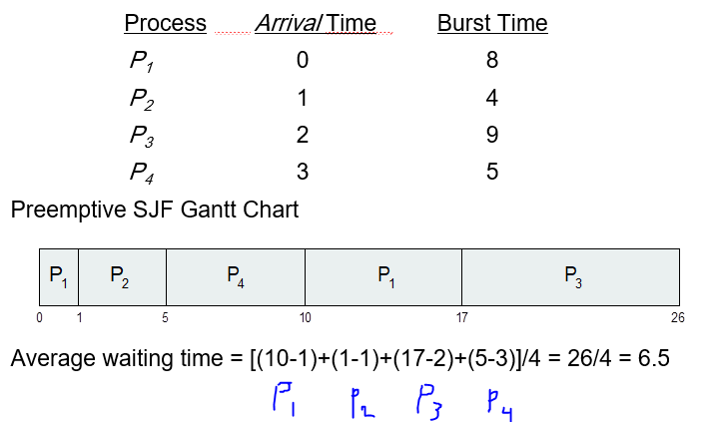
Shortest-remaining-time-first

Slide 43
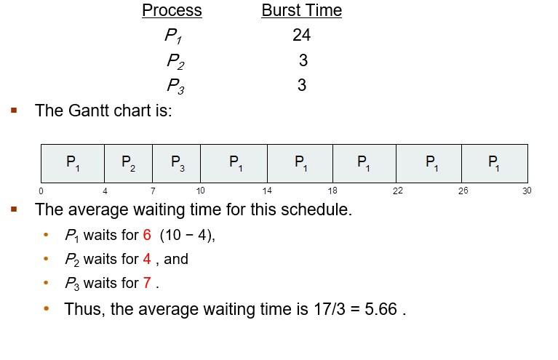
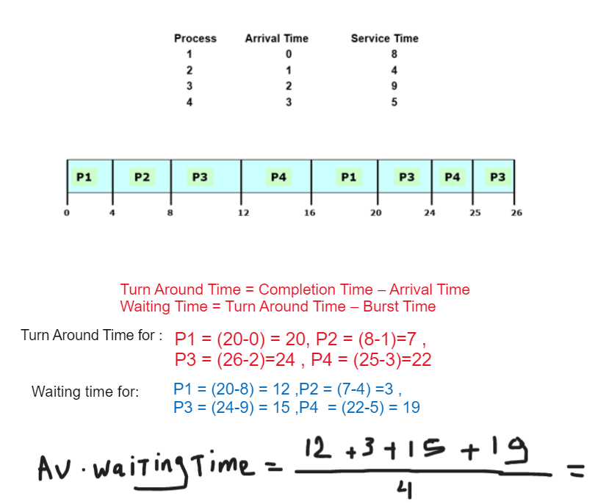
Round Robin (RR)
Each process gets a small unit of CPU time (time quantum q). After this time has elapsed, the process is preempted and added to the end of the ready queue.
Timer interrupts every quantum to schedule next process
Let :Quantum = 4

Slide 44
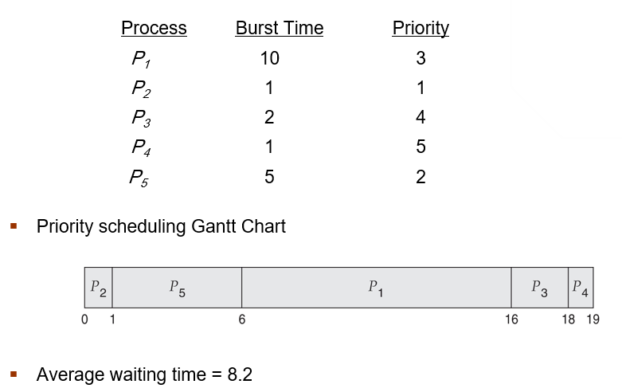
Priority Scheduling
A priority number (integer) is associated with each process
If coming process is higher priority than the current one, then it will be work and the current one will wait.
The CPU is allocated to the process with the highest priority (smallest integer ≡ highest priority)
Preemptive (if coming process has less time than current one then serve the coming process and make current one wait)
Nonpreemptive
SJF is priority scheduling where priority is the inverse of predicted next CPU burst time
Problem ≡ Starvation – low priority processes may never execute
Solution ≡ Aging – as time progresses increase the priority of the process

Slide 45
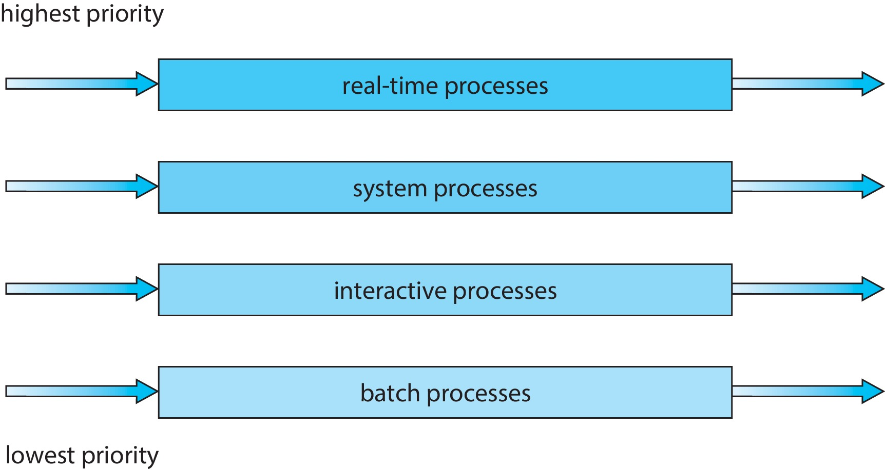
Multilevel Queue
With priority scheduling, have separate queues for each priority.
Multilevel Feedback Queue
A process can move between the various queues.
Multilevel-feedback-queue scheduler defined by the following parameters:
Number of queues
Scheduling algorithms for each queue
Method used to determine when to upgrade a process
Method used to determine when to demote a process
Method used to determine which queue a process will enter when that process needs service
Aging can be implemented using multilevel feedback queue

Slide 46
Multiple-Processor Scheduling
CPU scheduling more complex when multiple CPUs are available
Multiprocessor may be any one of the following architectures:
Multicore CPUs
Multithreaded cores
Non-Uniform Memory Access (NUMA) systems
Heterogeneous multiprocessing
Approaches:
Asymmetric Multiprocessing
One approach is to have all scheduling decisions, I/O processing, and other system activities handled by a single processor —the master server
Other processors execute only user code
Pros: this approach is simple because only one core accesses the system data structures, reducing the need for data sharing
Cons: the master server becomes a potential bottleneck where overall system performance may be reduced
Symmetric Multiprocessing (SMP)
Each processor is self-scheduling;
scheduler for each processor examine the ready queue and select a thread/process to run

Slide 47
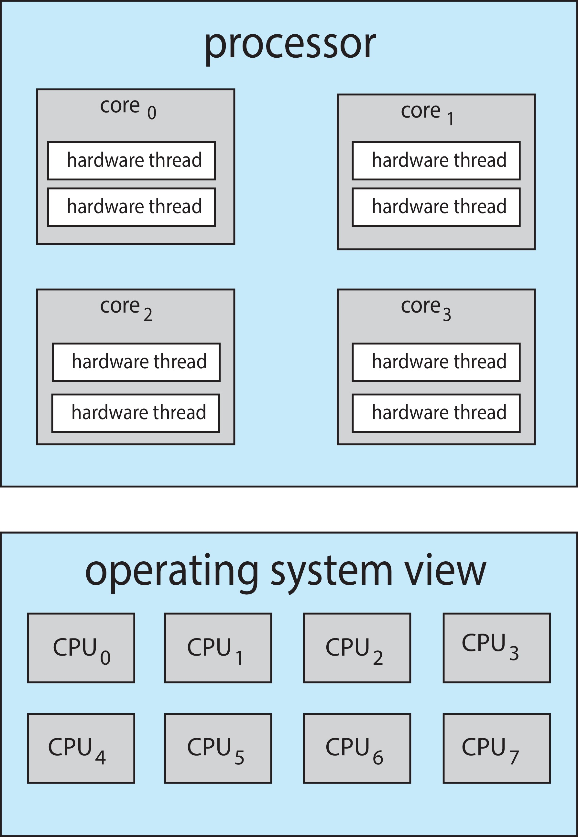
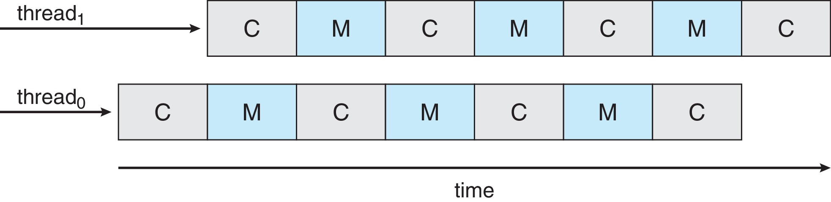
Multithreaded Multicore System
Also called: chip multithreading (CMT) : assigns each core multiple hardware threads. (Intel refers to this as hyperthreading.)
To overcome the Memory Stall,
Implement the multithreaded processing cores in which two (or more) hardware threads are assigned to each core:
each core has > 1 hardware threads
if one thread has a memory stall, switch to another thread! (hardware thread)

Slide 48
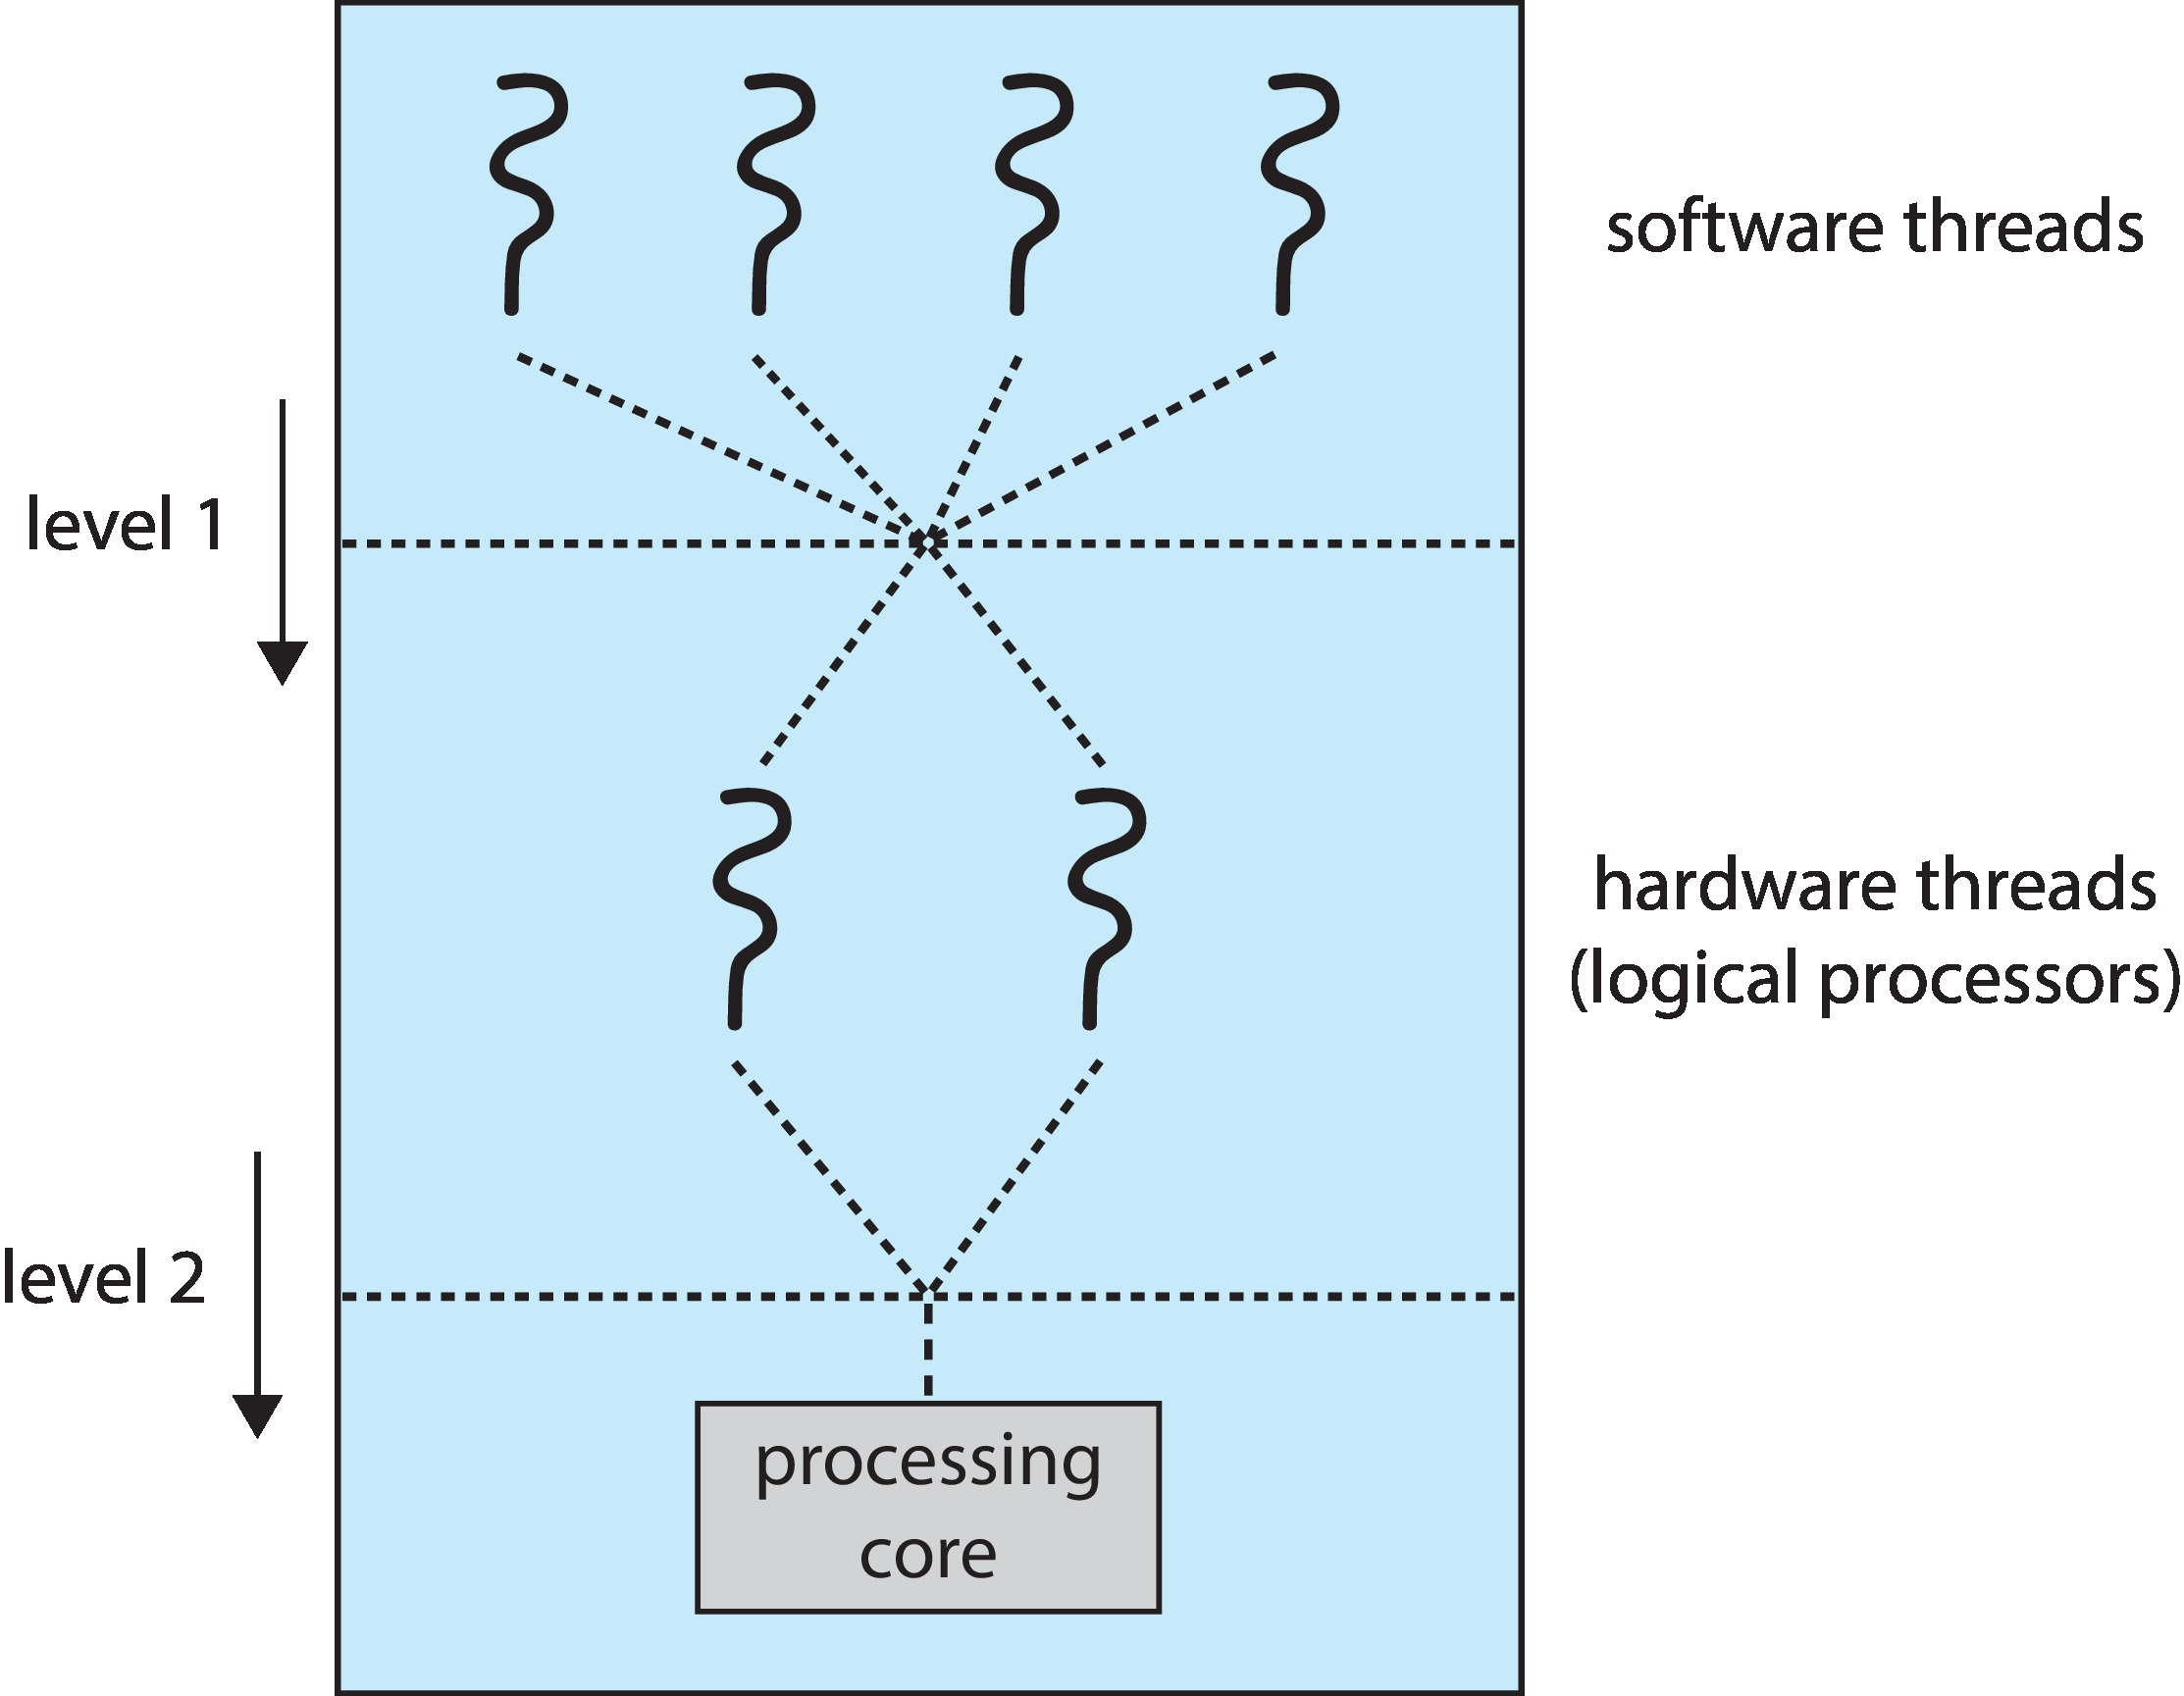
Cont. Multithreaded Multicore System
Two levels of scheduling:
The operating system deciding which software thread to run on a logical CPU
How each core decides which hardware thread to run on the physical core.
Load balancing attempts to keep workload evenly distributed
Push migration – periodic task checks load on each processor, and if found
Pushes task from overloaded CPU to other CPUs
Pull migration – idle processors pulls waiting task from busy processor
Processor Affinity : When a thread has been running on one processor, the cache contents of that processor stores the memory accesses by that thread.
Load balancing may affect processor affinity as a thread may be moved from one processor to another to balance loads, yet that thread loses the contents of what it had in the cache of the processor it was moved off of.
Soft affinity – the operating system attempts to keep a thread running on the same processor, but no guarantees.
Hard affinity – allows a process to specify a set of processors it may run on.

Slide 49
NUMA and CPU Scheduling
If the operating system is NUMA-aware, it will assign memory closes to the CPU the thread is running on.
two physical processor chips each with its own CPU and local memory.
A CPU has faster access to its local memory than to memory local to another CPU.

Slide 50
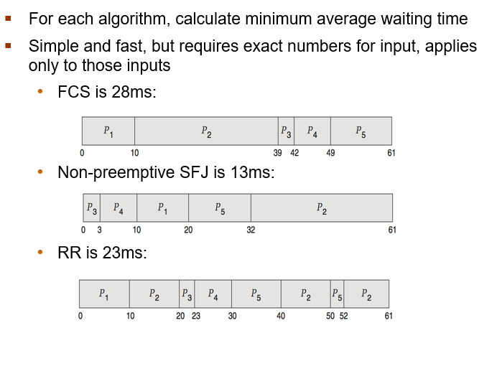
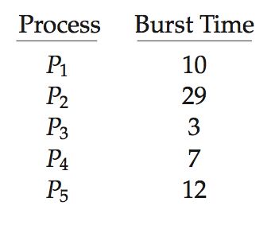
Deterministic Evaluation
Consider 5 processes arriving at time 0:

Slide 51
Why synchronization
When we have multiple processes running at the same time (i.e., concurrently) we know that we must protect them from one another
E.g., protect one process’ memory from access by another process
But what if we want to have those processes/ threads cooperate to solve a single problem?
E.g., one thread that manages, the mouse and keyboard, another that manages the display and a third that runs your programs
In this case, the processes/threads must be synchronized
For cooperating processes, the order of some instructions are irrelevant. However, certain instruction combinations must be prevented
For example:
Process A Process B concurrent access
A = 1; B = 2; does not matter
A = B + 1; B = B * 2; important!
A race condition is a situation where two or more processes access shared data concurrently. Result differs depending on who wins the race to it!
Concurrent access to shared data may result in data inconsistency
Maintaining data consistency requires mechanisms to ensure the orderly execution of cooperating processes

Slide 52
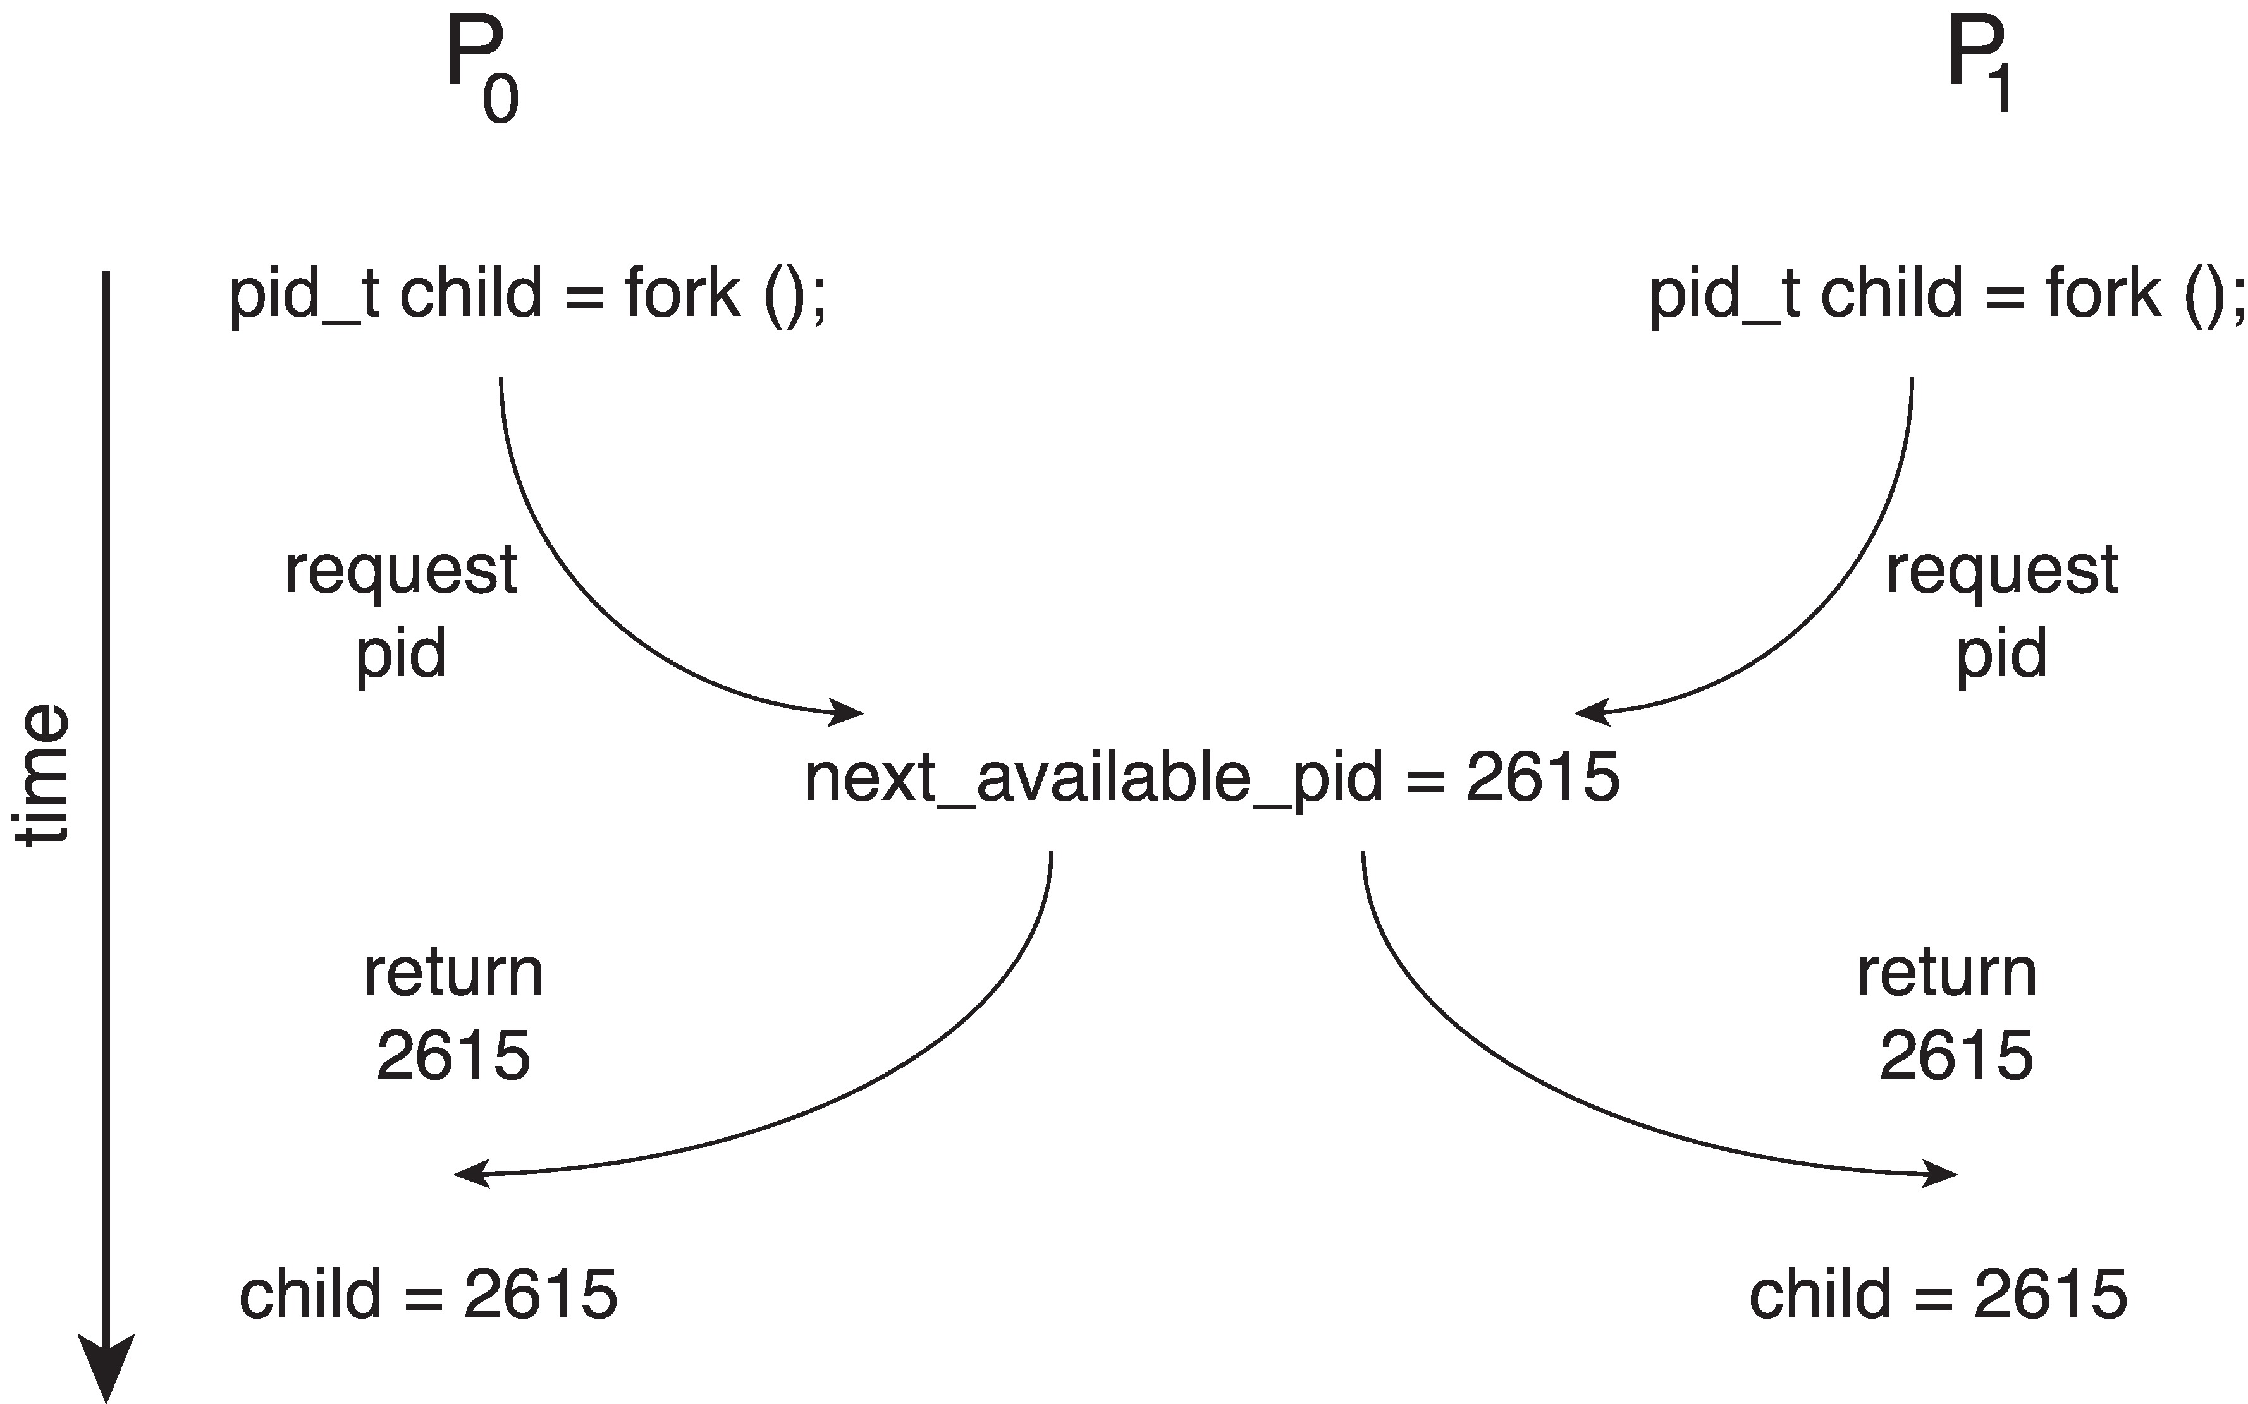
Race Condition
is a situation where the behavior and outcome of a program depend on the timing and sequence of events that occur concurrently, or in parallel, with other processes or threads.
More specifically, a race condition occurs when two or more processes or threads access a shared resource, such as a file, database, or memory location, in an uncoordinated and unpredictable manner. This can result in unexpected behavior, errors, or crashes in the program.
For example, consider a scenario where two processes are attempting to update the same file. If the processes do not coordinate their access to the file, one process may overwrite the changes made by the other, leading to data corruption. Alternatively, if two threads are updating the same variable in memory simultaneously, the value of the variable may be unpredictable, leading to incorrect program behavior.
To prevent race conditions, operating systems often provide synchronization mechanisms, such as locks, semaphores, and monitors, that allow processes or threads to coordinate their access to shared resources and avoid conflicts.

Slide 53
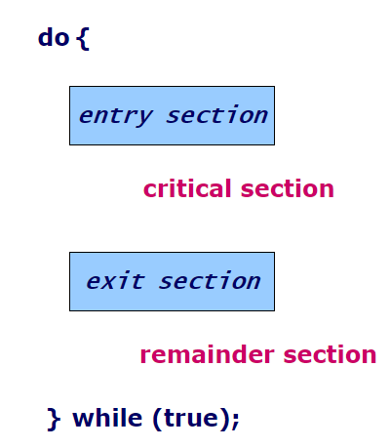
Critical Section Problem
The critical section refers to the segment of code where processes accesses
hared resources, such as common variables and files
Each process has critical section segment of code
Process may be changing common variables, updating table, writing file, etc.
When one process in critical section, no other may be in its critical section
Each process must ask permission to enter critical section in entry section, may follow critical section with exit section, then remainder section
A solution to the critical-section problem must satisfy the following requirements:
Mutual Exclusion
if process P_{i} is executing in its critical section, then no other processes can be executing in their critical sections
Progress
if no process is executing in its critical section and there exist some processes that wish to enter their critical section, then
only processes that are not executing in their remainder sections can participate in deciding who will enter its critical section next
additionally, the selection cannot be postponed indefinitely
Bounded Waiting
A bound/limit must exist on the number of times that other processes are allowed to enter their critical sections after a process has made a request to enter its critical section and before that request is granted

Slide 54
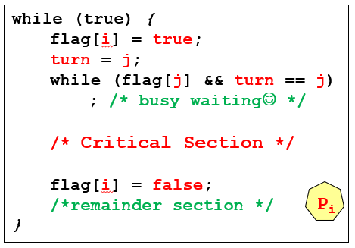
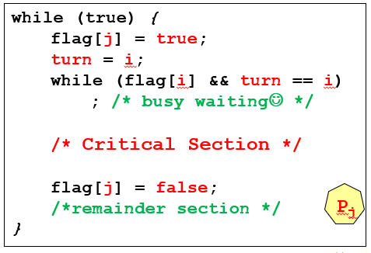
CS Solution
Peterson’s Solution :
The two processes share two variables:
int turn;
boolean flag[2];
The variable turn indicates whose turn it is to enter the critical section;
if turn == i, then process P_{i} is allowed to execute in its critical section
The flag array is used to indicate if a process is ready to enter the critical section
if flag[i] == true implies that process P_{i} is ready to enter its critical section
To enter the critical section:
Thread P_{i} first sets flag[i] to be true
Then sets turn to the value j,
This asserting that if the other process (P_{j}) wishes to enter the critical section, it can do so
Provable that the three Critical-Section (CS) requirement are met.

Slide 55
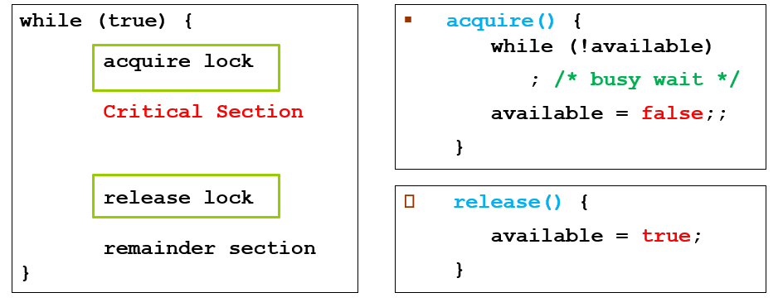
Higher-Level Software Tools to the CS Problem
1. Mutex Locks (MUTual Exclusion Lock) :
A very simple lock used to protect critical sections and prevent race conditions
A process must acquire the lock before entering a critical section
It releases the lock when it exits the critical section (after the CS)
Protect a critical section by first acquire() a lock then release() the lock
Boolean variable indicating if lock is available or not
Calls to acquire() and release() must be atomic (uninterruptible)
These two functions { acquire() & release() } must be implemented atomically
Hardware instruction such as compare_and_swap() can be used to implement these functions

Slide 56
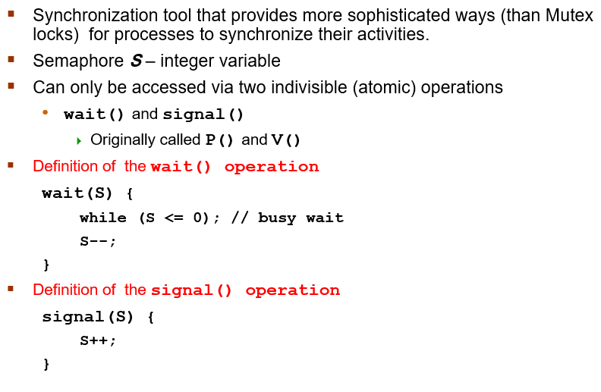
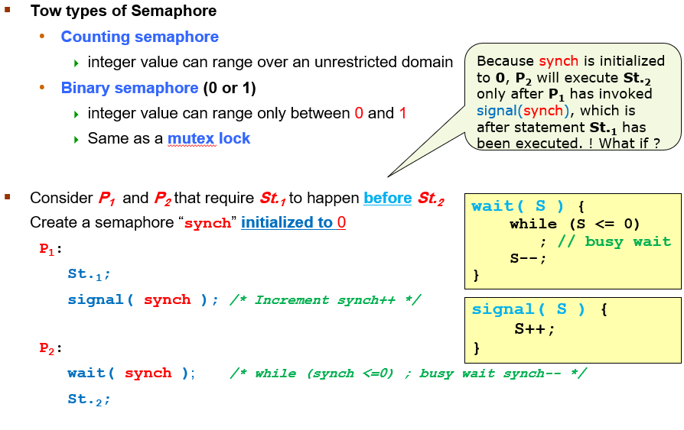
Semaphore
Notes:
A counting semaphore is a synchronization primitive that allows multiple threads to access a shared resource simultaneously, up to a certain limit. It keeps track of the number of available resources and allows access to them if they are available, or blocks the threads if all resources are currently being used.
A mutex, on the other hand, is a synchronization primitive that allows only one thread to access a shared resource at a time. It provides exclusive access to a resource and blocks other threads from accessing it while it is locked.

Slide 57
Cont. Semaphore Implementation
Must guarantee that no two processes can execute the wait() and signal() on the same semaphore at the same time
Thus, the implementation becomes the critical section (CS) problem where the wait and signal code are placed in the CS itself
Could now have busy waiting in CS implementation
But implementation code is short
Little busy waiting if critical section is rarely occupied
Note: that applications may spend lots of time in CS and therefore this is not a good solution ☹
Incorrect use of semaphore operations can occur:
Each process must execute wait(mutex) before entering the critical section and signal(mutex) afterward.
Notes:
Mutex and Semaphore are two different synchronization techniques used to coordinate access to shared resources in concurrent programming. Although they are similar in some ways, they have some important differences.
Mutex is a synchronization technique that allows only one process or thread to access a shared resource at a time. It provides exclusive access to a resource and blocks other processes or threads from accessing it while it is locked. Mutex is typically used to protect a single shared resource, such as a file or a block of memory.
Semaphore, on the other hand, is a synchronization technique that allows multiple processes or threads to access a shared resource simultaneously, up to a certain limit. It keeps track of the number of available resources and allows access to them if they are available, or blocks the processes or threads if all resources are currently being used. Semaphore is typically used to protect a pool of shared resources, such as a fixed number of network connections or threads.

Slide 58
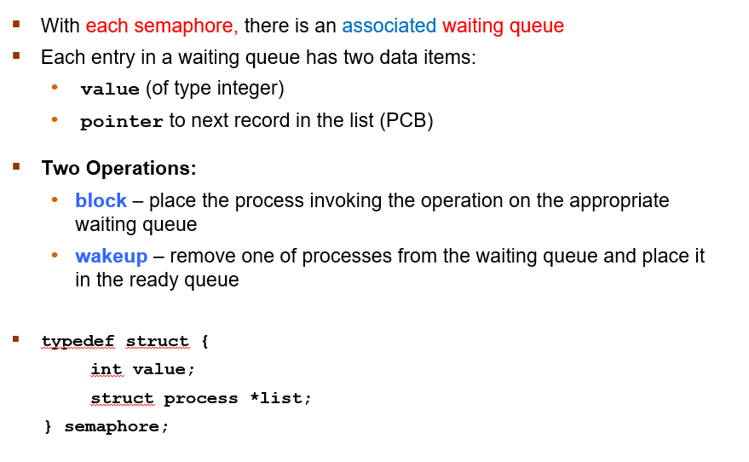
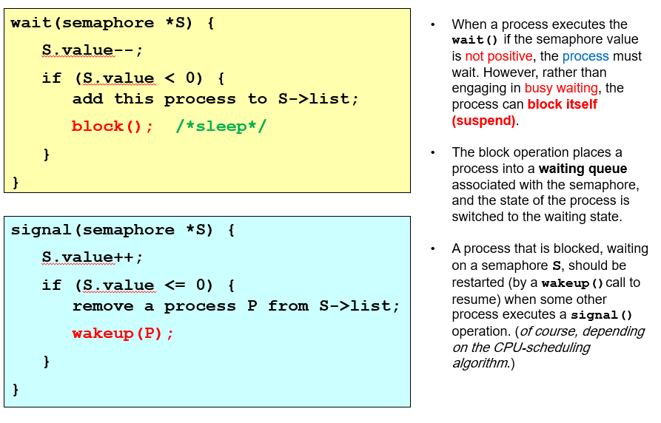
Cont. Semaphore Implementation with NO Busy waiting

Slide 59
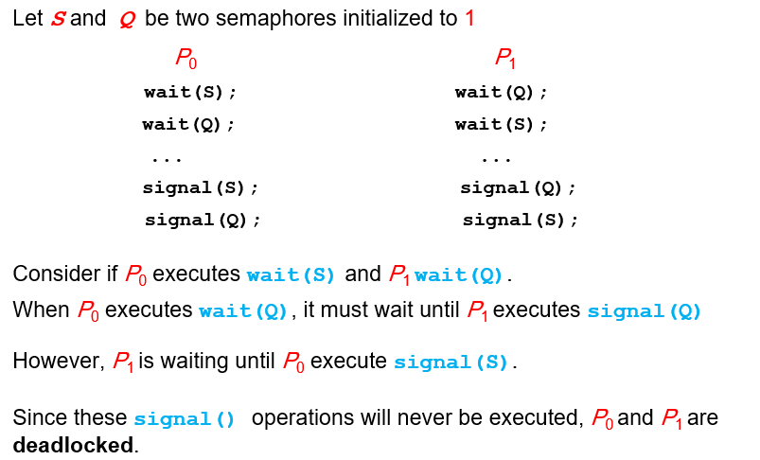
Liveness
Processes may have to wait indefinitely while trying to acquire a synchronization tool such as a mutex lock or semaphore
Liveness refers to a set of properties that a system must satisfy to ensure processes make progress
Indefinite waiting is an example of a liveness failure
Deadlock – two or more processes are waiting indefinitely for an event that can be caused by only one of the waiting processes
Other forms of deadlock:
Starvation – indefinite blocking
A process may never be removed from the semaphore queue in which it is suspended
Priority Inversion – Scheduling problem when lower-priority process holds a lock needed by higher-priority process
Solved via priority-inheritance protocol

Slide 60
Priority Inheritance Protocol
Consider the scenario with three processes P1, P2, and P3.
P1 has the highest priority,
P2 the next highest, and
P3 the lowest.
Assume a P3 is assigned a resource R that P1 wants.
Thus, P1 must wait for P3 to finish using the resource.
However, P2 becomes runnable and preempts P3.
What has happened is that P2 - a process with a lower priority than P1 - has indirectly prevented P3 from gaining access to the resource.
To prevent this from occurring, a priority inheritance protocol is used.
This simply allows the priority of the highest thread waiting to access a shared resource to be assigned to the thread currently using the resource.
Thus, the current owner of the resource is assigned the priority of the highest priority thread wishing to acquire the resource.

Slide 61
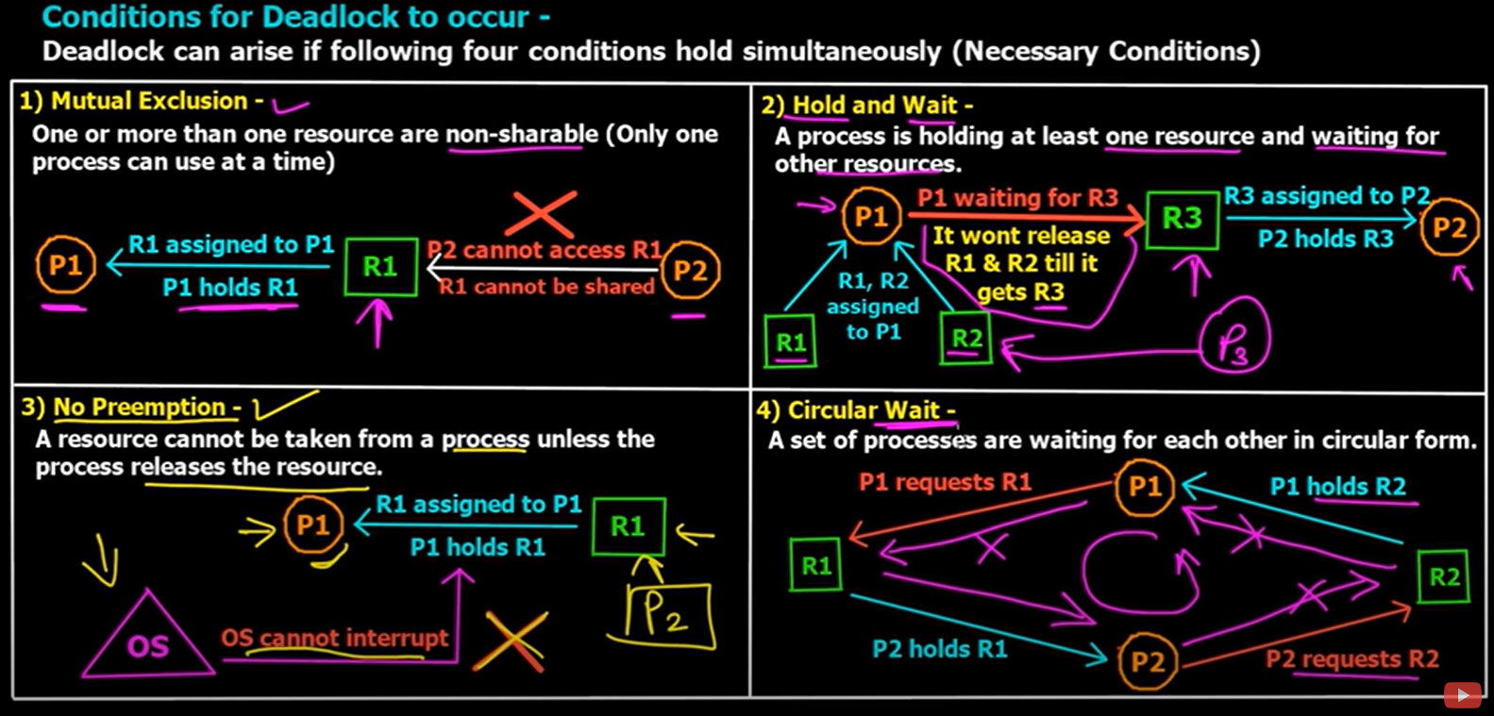
System Model
System consists of resources
Each resource type R_{i} has W_{i} instances.
Each process utilizes a resource as follows:
Request
Use , hold , assignment
Release
Deadlock can arise if four conditions hold simultaneously.
Mutual exclusion:
Only one process at a time can use a resource
Hold and wait:
A process holding at least one resource is waiting to acquire additional resources held by other processes
No preemption:
A resource can be released only voluntarily by the process holding it, after that process has completed its task
Circular wait:
There exists a set {P₀, P₁, …, P_{n}} of waiting processes such that P₀ is waiting for a resource that is held by P₁,
P₁ is waiting for a resource that is held by P₂, …,
P_{n–1} is waiting for a resource that is held by P_{n},
and P_{n} is waiting for a resource that is held by P₀.

Slide 62
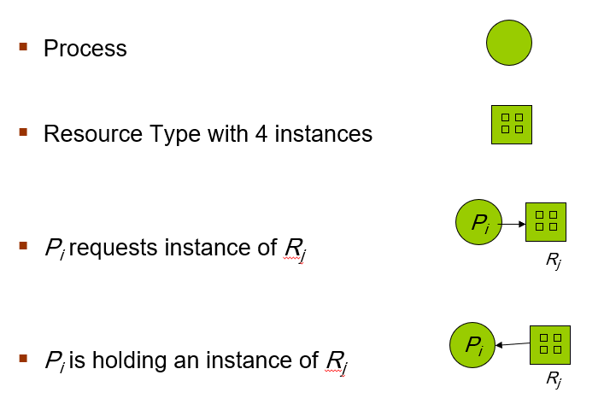
Resource-Allocation Graph
Deadlocks can be described in terms of a directed graph called a system resource-allocation graph.
A set of vertices V and a set of edges E.
V is partitioned into two types:
P = {P₁, P₂, …, P_{n}},
the set consisting of all the processes in the system
R = {R₁, R₂, …, R_{m}},
the set consisting of all resource types in the system
Request edge – directed edge P_{i} → R_{j}
Assignment edge – directed edge R_{j} → P_{i} (or P_{i} ← R_{j} )

Slide 63
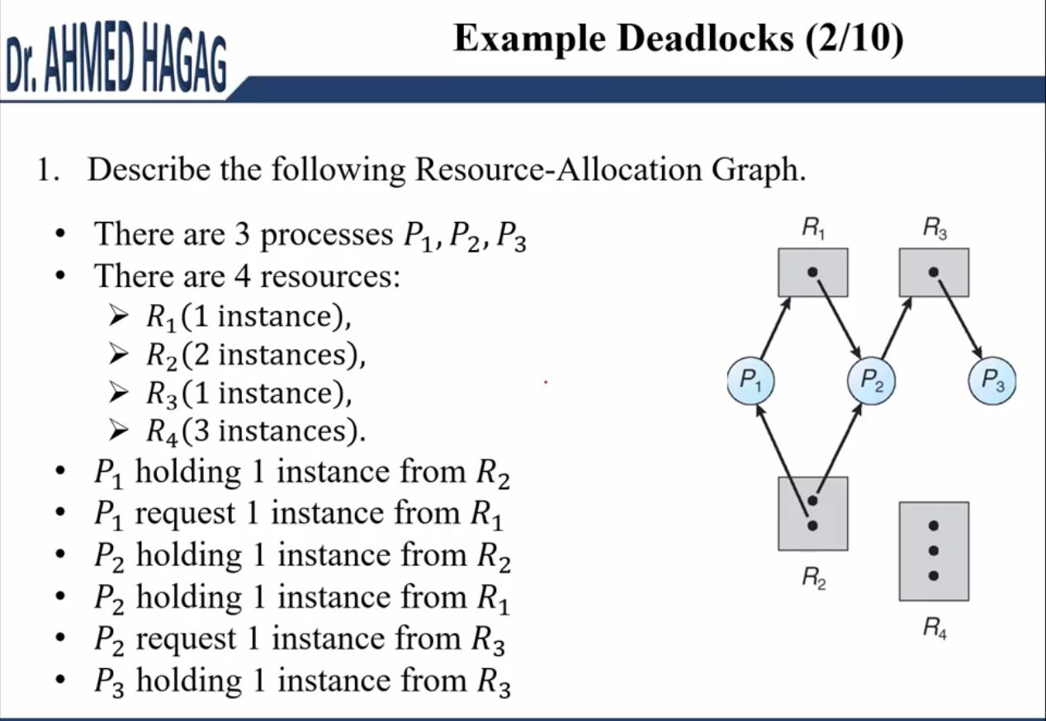

Deadlock (Resource Allocation Example)

Slide 64


Resource Allocation Graph
With A Deadlock
No Deadlock
If graph contains no cycles ⇒ no deadlock
If graph contains a cycle ⇒
if only one instance per resource type, then deadlock
if several instances per resource type, possibility of deadlock
Notes:
After a period of time the process will release the resource and it will be free so another process can hold it.

Slide 65
Methods for Handling Deadlocks
Prevent deadlocks, by negating one of the four necessary conditions.
Avoid deadlocks, by careful resource allocation. This requires that the operating system be given in advance additional information concerning which resources a process will request and use during its lifetime.
Recover from deadlocks: Allow the system to enter a deadlock state and then recover.
Ignore the problem and pretend that deadlocks never occur in the system (The ostrich algorithm).

Slide 66
Deadlock Prevention
Simply, Invalidate one of the four necessary conditions for deadlock:
Mutual Exclusion
Some resources, such as files, may allow multiple accesses for reads but only exclusive access for writes
Even in this case, deadlock can occur if more than one process requires write permission
Hold and Wait
must guarantee that whenever a process requests a resource, it does not hold any other resources
Approach #1: require process to request and be allocated all its resources before it begins execution,
Cons: Low resource utilization
Approach #2: allows a process to request resources only when it has none allocated to it.
Cons: may lead to starvation, wait indefinitely
No Preemption –
If a process is holding some resources and requests another that cannot be immediately allocated to it, then all resources currently being held are released (preempted)
Preempted resources are added to the list of resources for which the process is waiting
Process will be restarted only when it can regain its old resources as well as the new ones that it is requesting
Circular Wait – preventing it is a practical solution ☺
imposing a total ordering of all resource types and require that each process requests resources in an increasing order of enumeration.
Deadlock-prevention algorithms prevent deadlocks by limiting how requests & releases can be made.
Pros: The limits ensure that at least one of the necessary conditions for deadlock cannot occur
Cons: Possible side effects of preventing deadlocks by this method,
low device utilization and
reduced system throughput

Slide 67
Deadlock Avoidance
Requires that the system has some additional a priori information available, (require additional information about how resources are to be requested)
Simplest and most useful model requires that
each process declare the maximum number of resources of each type that it may need
The deadlock-avoidance algorithm
dynamically examines the resource-allocation state to ensure that there can never be a circular-wait condition
Resource-allocation state is defined by
the number of available and allocated resources, and
the maximum demands of the processes

Slide 68


Safe State
When a process requests an available resource, system must decide if immediate allocation leaves the system in a safe state.
System is in safe state if there exists a safe sequence of all processes.
Sequence <P₁, P₂, …, P_{n}> is safe if for each P_{i}, the resources that Pi can still request can be satisfied by currently available resources + resources held by all the P_{j}, with j < i.
If P_{i} resource needs are not immediately available, then P_{i} can wait until all P_{j} have finished.
When P_{j} is finished, P_{i} can obtain needed resources, execute, return allocated resources, and terminate.
When P_{i} terminates, P_{i+1} can obtain its needed resources, and so on.
If a system is in safe state ⇒ no deadlocks
If a system is in unsafe state ⇒ possibility of deadlock
Avoidance ⇒ ensure that a system will never enter an unsafe state.

Slide 69

Claim edge
introduce a new type of edge, called Claim edge P_{i} ---→ R_{j} indicated that process P_{i} may request resource R_{j}; represented by a dashed line (-----)
Claim Edge converts to Request Edge when a process requests a resource
Request Edge converted to an Assignment Edge when the resource is allocated to the process
When a resource is released by a process, assignment edge
reconverts back to a Claim Edge
Resources must be claimed a priori in the system

Slide 70

Avoidance Algorithms
Single instance of a resource type: Use a resource-allocation graph

Slide 71
Cont. Avoidance Algorithms
Multiple instances of a resource type : Use the Banker’s Algorithm
Each process must a priori claim maximum use
When a process requests a resource, it may have to wait
When a process gets all its resources it must return them in a finite amount of time
Let n = number of processes, and m = number of resources types.
Available: Vector of length m. If available [j] = k, there are k instances of resource type R_{j} available
Max: n x m matrix. If Max [i,j] = k, then process P_{i} may request at most k instances of resource type R_{j}
Allocation: n x m matrix. If Allocation[i,j] = k then P_{i} is currently allocated k instances of R_{j}
Need: n x m matrix. If Need[i,j] = k, then P_{i} may need k more instances of R_{j} to complete its task
Need [i,j] = Max[i,j] – Allocation [i,j]
Steps:
Let Work and Finish be vectors of length m and n, respectively. Initialize:
Work = Available
Finish [i] = false for i = 0, 1, …, n- 1 (initially False for all processes)
Find an i such that both:
(a) Finish [i] = false
(b) Need_{i} ≤ Work
If no such i exists, go to step 4
Work = Work + Allocation_{i} (free the raised resources to reuse it). Finish[i] = true go to step 2
If Finish [i] == true for all i, then the system is in a safe state ,otherwise the system is unsafe.

Slide 72



Example of Banker’s Algorithm
Resource-allocation state

Slide 73


In the last Ex, what if Request₁(1,0,2)
We find that it will be safe state with the sequence <p1,p3,p4,p0,p2>

Slide 74

Background
Program must be brought (from disk) into memory (RAM) and placed within a process for it to be run
CPU can access directly only Main Memory (RAM) and Registers
Memory unit only sees a stream of:
addresses + read requests, or
address + data and write requests
Register access is done in one CPU clock (or less)
Main Memory can take many cycles, causing a stall
Cache sits between main memory (RAM) and CPU registers
Protection of memory is required to ensure correct and safe operation
Need to ensure that a process can access only those addresses in its address space
We can provide this protection by using a pair of base and limit registers define the logical address space of a process

Slide 75

Hardware Address Protection
CPU must check every memory access generated in user mode to be sure it is between base and limit for that user
The instructions to loading the base and limit registers are privileged
Notes:
Is the address higher than or equal the base and less than (base+limit)? If yes ,store it into memory otherwise exception.

Slide 76


Logical vs. Physical Address
Memory-Management Unit (MMU) : Hardware device that maps virtual to physical address
The base register now called relocation register
The value in the relocation register is added to every address generated by a user process at the time it is sent to memory

Slide 77
Contiguous Allocation (not important)
Main memory must support both OS and user processes
Limited resource, must allocate efficiently
Contiguous allocation is one early method
Main memory usually into two partitions:
Resident operating system, usually held in low memory with interrupt vector
User processes then held in high memory
Each process contained in single contiguous section of memory
Relocation registers used to protect user processes from each other, and from changing operating-system code and data
Base register contains value of smallest physical address
Limit register contains range of logical addresses – each logical address must be less than the limit register
MMU maps logical address dynamically
Can then allow actions such as kernel code being transient and kernel changing size

Slide 78

Variable Partition
Multiple-partition allocation
Degree of multiprogramming limited by number of partitions
Variable-partition sizes for efficiency (sized to a given process’ needs)
Hole – block of available memory; holes of various size are scattered throughout memory
When a process arrives, it is allocated memory from a hole large enough to accommodate it
Process exiting frees its partition, adjacent free partitions combined
Operating system maintains information about: a) allocated partitions b) free partitions (hole)

Slide 79
Dynamic Storage-Allocation Problem
How to satisfy a request of size n from a list of free holes?
First-fit: Allocate the first hole that is big enough
Best-fit: Allocate the smallest hole that is big enough;
must search entire list, unless ordered by size
Produces the smallest leftover hole
Worst-fit: Allocate the largest hole;
must also search entire list
Produces the largest leftover hole
First-fit and best-fit better than worst-fit in terms of speed and storage utilization

Slide 80
Fragmentation
External Fragmentation – total memory space exists to satisfy a request, but it is not contiguous (free spaces left between process in memory and we can merge them to one big hole)
Internal Fragmentation – allocated memory may be slightly larger than requested memory; this size difference is memory internal to a partition, but not being used (the free size left for a partition when process stored in a partition bigger than its size)
Reduce external fragmentation by compaction
Shuffle memory contents to place all free memory together in one large block
Compaction is possible only if relocation is dynamic, and is done at execution time
Notes:
Explain the difference between internal and external fragmentation.
• Internal fragmentation is unused allocated area
• external fragmentation is unallocated area and unused

Slide 81

Paging
Physical address space of a process can be noncontiguous; process is allocated physical memory whenever the latter is available
Divide physical memory into fixed-sized blocks called frames
Divide logical memory into blocks of same size called pages
The page size (like the frame size) is defined by the hardware
Page size is a power of 2, typically varying between 4 KB and 1 GB per page
Keep track of all free frames
To run a program of size N pages, need to find N free frames and load program
Set up a page table to translate logical to physical addresses
Cons : Still have Internal fragmentation
Address generated by CPU is divided into:
Page number (p) – used as an index into a page table which contains base address of each page in physical memory
Page offset (d) – combined with base address to define the physical memory address that is sent to the memory unit
For given logical address space 2^{m} and page size 2^{n}
p is an index into the page table and d is the displacement within the page
Notes:
Address space = # of pages (frames) x page (frame) size
Page number (p) = logical address (m) / frame size
Page offset (d) = logical address % frame size
Get the frame number mapped to page number then -> physical address = frame# * frame_size + page_offset

Slide 82


Paging Hardware
Steps taken by the MMU to translate a logical address generated by the CPU to a physical address:
Extract the page number p and use it as an index into the page table
Extract the corresponding frame number f from the page table
Replace the page number p in the logical address with the frame number f
As the offset d does not change, it is not replaced, and the frame number and offset now comprise the physical address.
Address space = # of pages (frames) x page (frame) size

Slide 83


Paging Example
Page 0
Frame 0
Page size of 4 bytes
Logical address: m = 4 and n = 2;
Physical memory of 32 bytes (8 frames)
Physical address = Frame number x frame size + offset
Indexing into the page table, we find that page 0 is in frame 5. Thus,
Logical address 0 maps to physical address 20 [= (5 × 4) +0].
Logical address 3 (page 0, offset 3) maps to physical address 23 [= (5 × 4) + 3].
Page# =(int) ¾ = 0.
Offset = 3 % 4 = 3.
Logical address 4 (page 1, offset 0); according to the page table, page 1 is mapped to frame 6. Thus, logical address 4 maps to physical address 24 [= (6 × 4) + 0].
Logical address 13 maps to physical address 9.
Page 1
Frame 1
Page 2
Frame 2
Page 3
Frame 3
Frame 4
Frame 5
Frame 6
Frame 7

Slide 84

Swapping
A process can be swapped temporarily out of memory to a backing store, and then brought back into memory for continued execution
Total physical memory space of processes can exceed physical memory
Backing store – fast disk large enough to accommodate copies of all memory images for all users; must provide direct access to these memory images
Roll out, roll in – swapping variant used for priority-based scheduling algorithms; lower-priority process is swapped out so higher-priority process can be loaded and executed
System maintains a ready queue of ready-to-run processes which have memory images on disk
Could swapping pages as processes.
System calls to inform OS of memory use via request_memory() and release_memory()

Slide 85

Virtual memory
Virtual memory
storage allocation scheme in which secondary memory can be addressed as though it were part of the main memory.
separation of user logical memory from physical memory
Only part of the program needs to be in memory for execution, therefore
Logical address space can be much larger than physical address space
Allows address spaces to be shared by several processes
More programs running concurrently
Less I/O needed to load or swap processes

Slide 86

Demand Paging
Could bring entire process into memory at load time Or bring a page into memory and the other pages are loaded only when they are needed
Less I/O needed,
Less memory needed
Faster response
More users
Page is needed ⇒ reference to it
invalid reference ⇒ abort
not-in-memory ⇒ bring it to memory
Lazy swapper – never swaps/bring a page into memory unless page will be needed
Swapper that deals with pages is a pager
Work with page fault principle

Slide 87


Valid-Invalid Bit
With each page table entry:
a valid–invalid bit is associated
v ⇒ in-memory – memory resident,
i ⇒ not-in-memory
Initially valid–invalid bit is set to i on all entries
During MMU address translation,
if valid–invalid bit in page table entry is i ⇒ page fault

Slide 88

Steps in Handling Page Fault
If there is a reference to a page,
The first reference to that page will trap to operating system
Page fault
Operating system looks at another table to decide:
Invalid reference ⇒ abort
Just not in memory
Find free frame
Swap page into frame via scheduled disk operation
Reset tables to indicate page now in memory
Set validation bit = v
Restart the instruction that caused the page fault

Slide 89

Page Replacement
Algorithms:
We will look at some page replacement schemes such as
FIFO Page Replacement
Optimal Page Replacement
Least Recently Used (LRU) Page Replacement
Counting algorithms

Slide 90

First-In-First-Out (FIFO) Algorithm

Slide 91

Ex: FIFO

Slide 92

Theoretically Optimal Page Replacement Alg. (OPT)

Slide 93

EX:OPT

Slide 94

Least Recently Used Algorithm (LRU)

